Slide 1
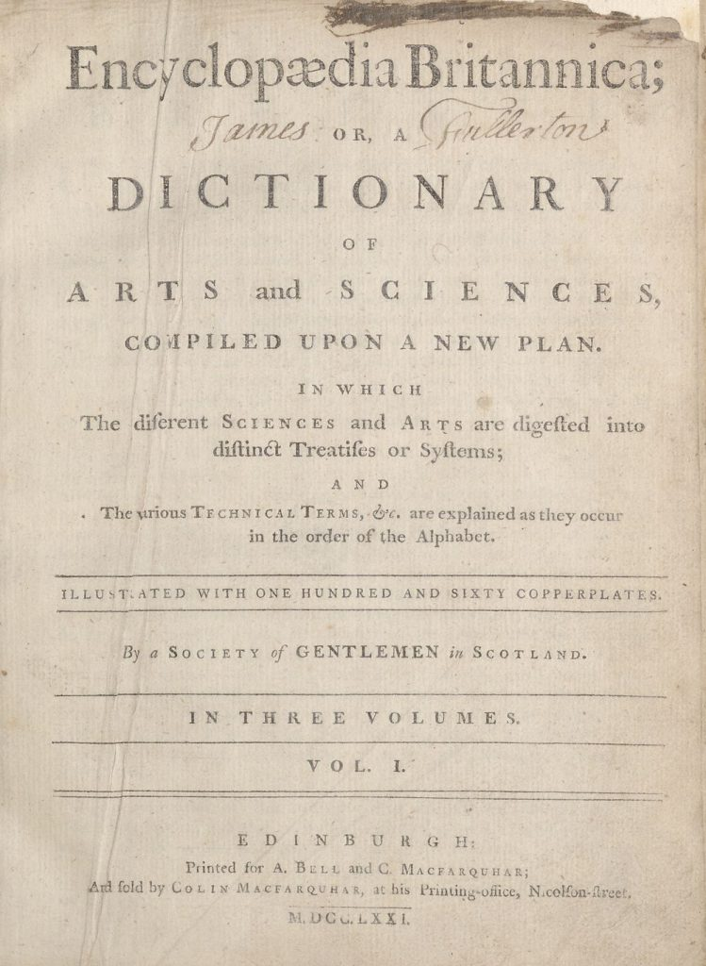
frances: An AI-toolbox to discover automatically insights from Data Foundry collections
Dr. Rosa Filgueira,
Assistant Professor,
Heriot-Watt University,
Email: R.Filgueira@hw.ac.uk

Slide 2
frances*: New AI-toolbox to discover automatically insights
New ways to unlock the full value of NLS digital collections
Objective 1 : New facilities to run more complex text analysis queries → ML/NLP techniques.
Objective 2: Full integration with NLS Data Foundry → Hide the large-scale text mining complexity
Using the Encyclopaedia Britannica as the core dataset
(*) Frances Wright (September 6, 1795 – December 13, 1852)

Slide 3
frances: Providing Automatic ML Analysis
frances will provide abstractions to a variety of ML/NLP techniques
→ Extract complex knowledge without being an expert data scientist
Train and use text embedding models
Employ topic mining, sentiment analysis, text summarization
Build knowledge graph(s) visualizing the results
Using the Encyclopaedia Britannica – frances will allow us automatically to
Group similar articles
Detect how articles have changed across editions
Extract the relationships between articles
Classify articles into different categories
Summarise articles
Analyse the sentiment expressed in an article
Overview of how the
Encyclopaedia Britannica
has changed over time
New suite of ML functionalities that can be used to analyse
any other Data Foundry collection

Slide 4
My Journey
From Semi-Structured EB information (ALTO & METS XML files) → Information Extraction → Knowledge Graph → Deep learning Transformers → To Augmented EB-Knowledge Graph with advance AI-methods
Querying Augment EB Knowledge Graph:
Extracting information already stored in the EB-Knowledge Graph
Processing information stored in the EB-Knowledge Graph in parallel → Create new data/results

Slide 5
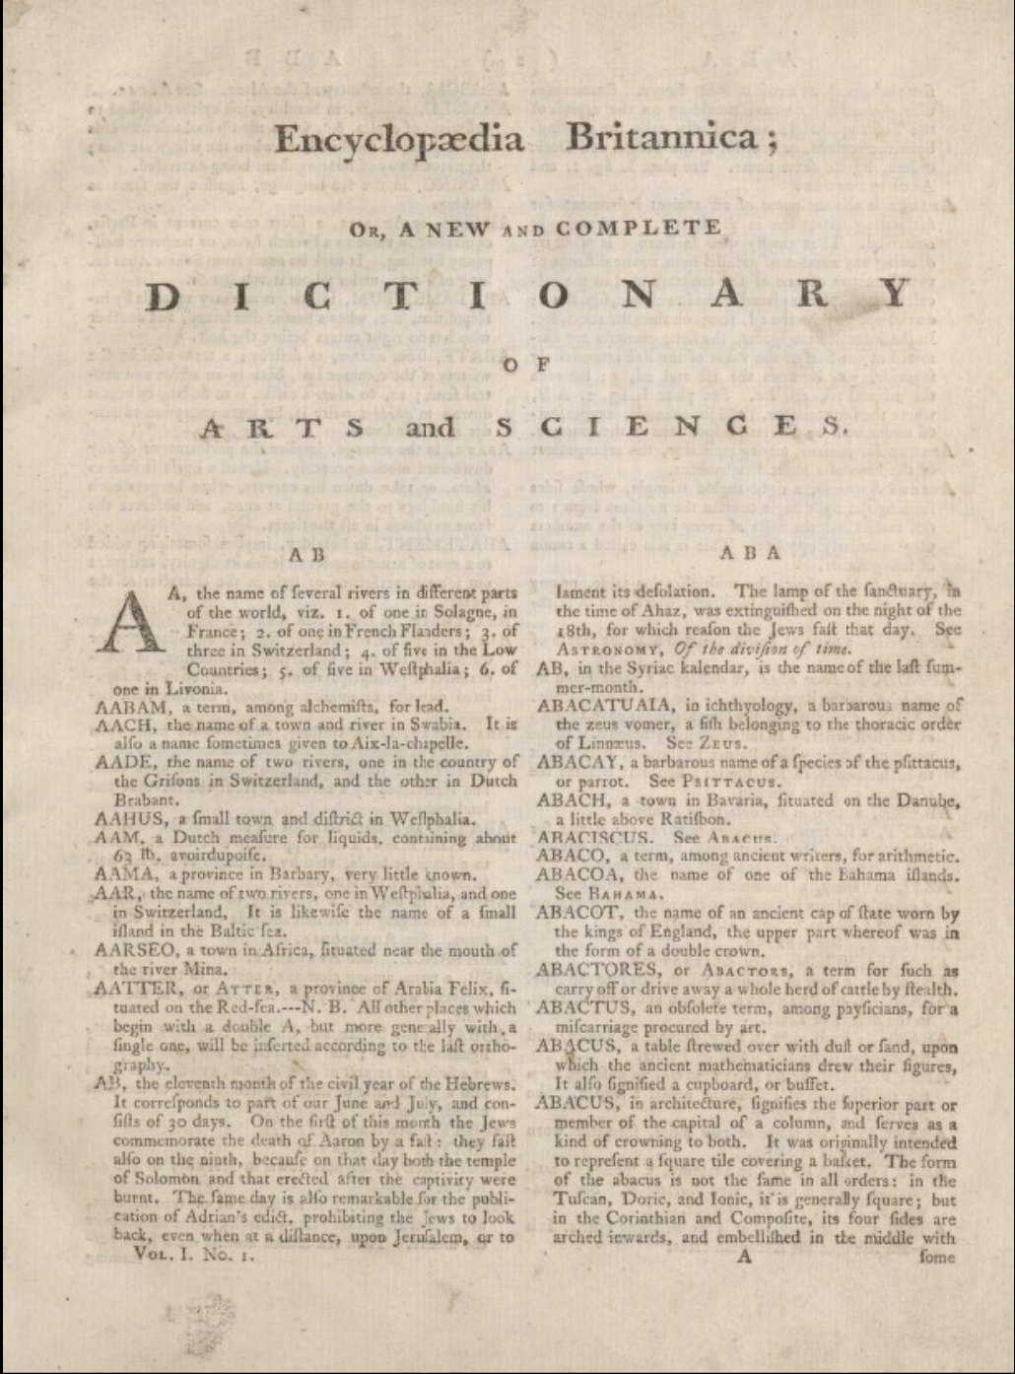
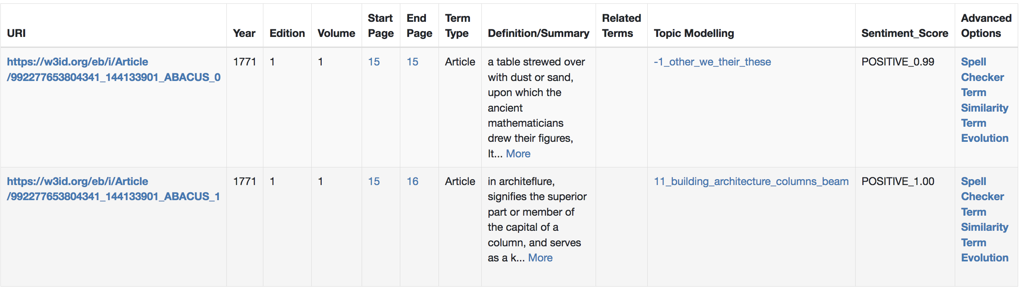
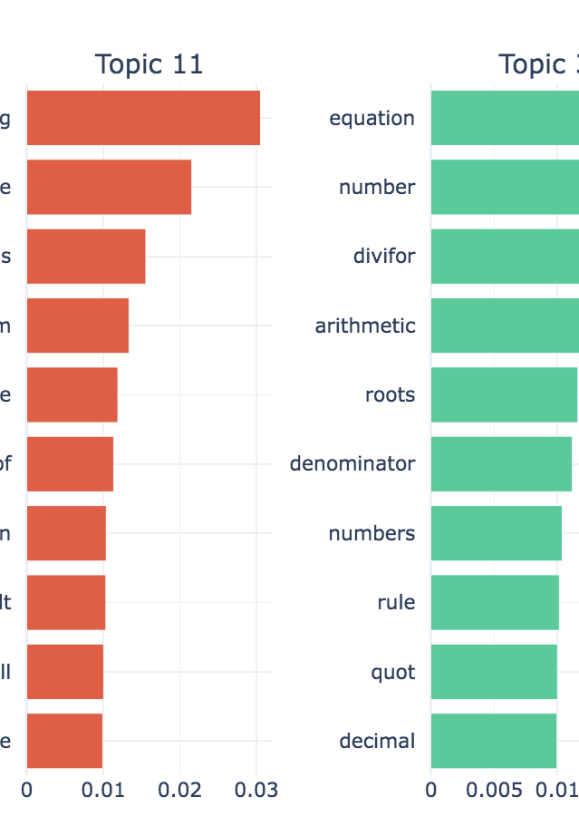
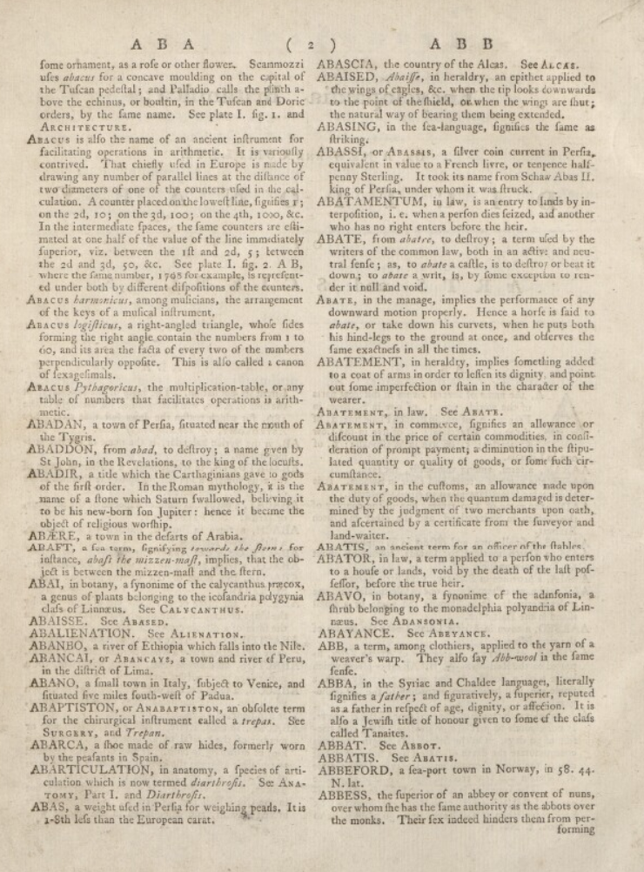
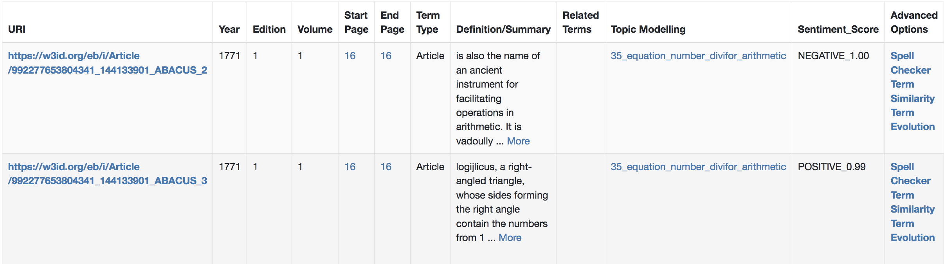
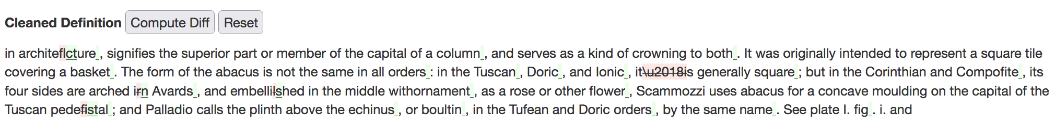
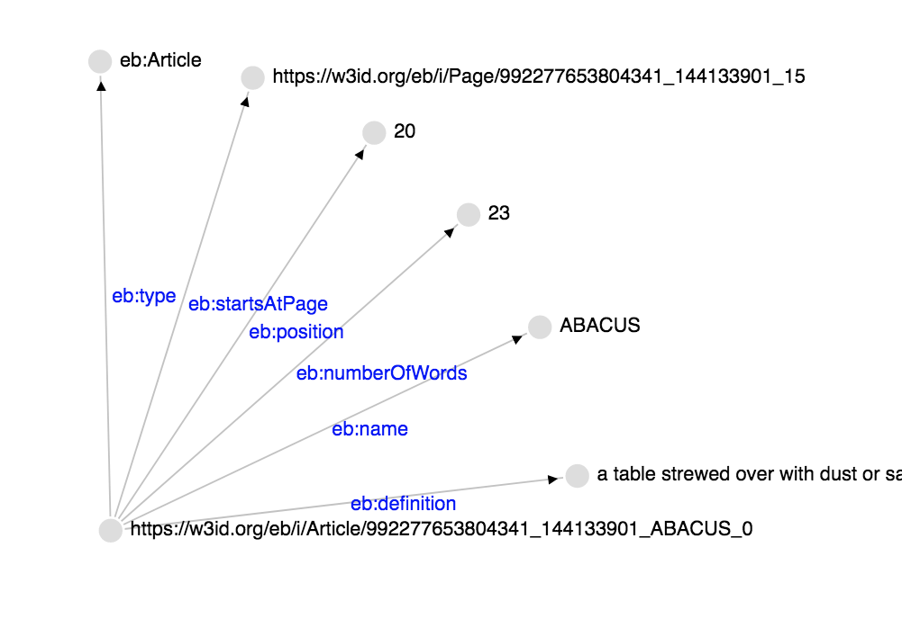
Edition 1, 1771
TERM ABACUS
My Journey
Applying advanced AI/NLP methods to historical digital collections

Slide 6
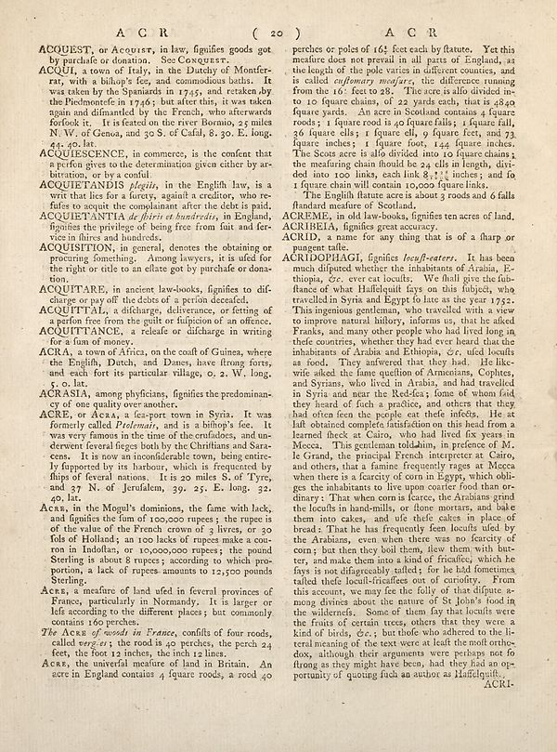
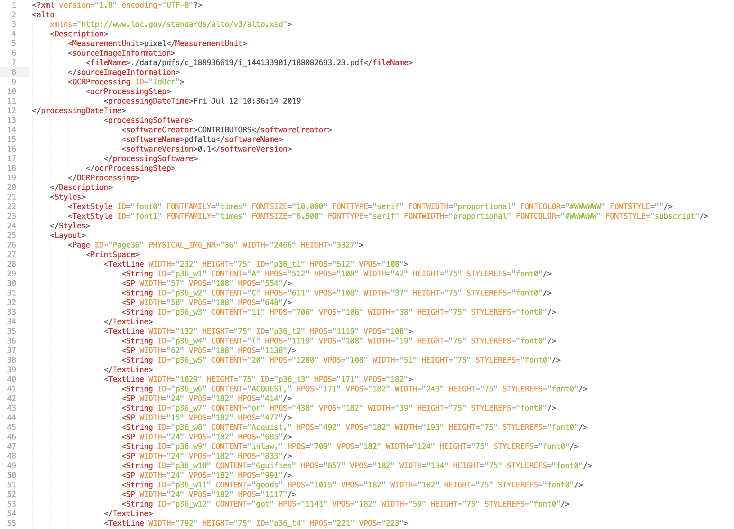
Phase 1: Information Extraction
Detect, Classify and Extract all the terms of the EB – different Editions
Two types of Terms:
Articles: 1 or 2 paragraphs describing a term ~ entry in a dictionary
Topics: Several pages describing a term
Extract Metadata from all EB editions and volumes.
How have we done it ? By using defoe to analyze METS and ALTO XML files
Page 36 of the First Edition
of the Encyclopaedia Britannica
ALTO-XML of the Page 36 of the First Edition of the Encyclopaedia Britannica
Notes:
In this work, we have updated defoe:
for supporting the ingestion of new digital collections.
For employing new techniques to mitigate OCR errors
For integrating geoparsing capabilities
For extracting commonalities across digital collections schemas

Slide 7
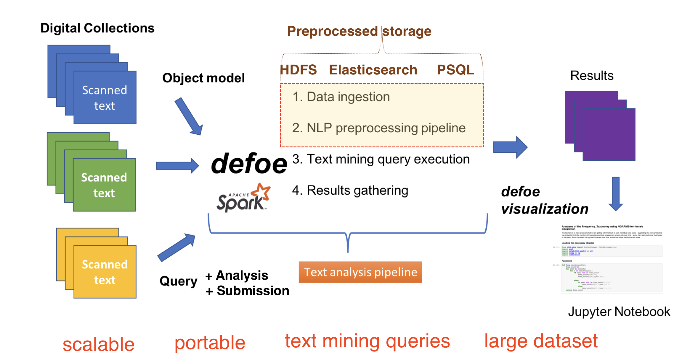
Phase 1: Information Extraction
defoe: scalable toolbox for historical research
https://github.com/defoe-code/defoe
Notes:
In this work, we have updated defoe:
for supporting the ingestion of new digital collections.
For employing new techniques to mitigate OCR errors
For integrating geoparsing capabilities
For extracting commonalities across digital collections schemas

Slide 8
Phase 1: Information Extraction
1.1. Improved defoe Extract Terms query → It extracts the Eb Terms by page and classify them between articles and topics (Terms v.1) → Using ALTO XML
Extracted Terms Based on Heuristics → Pages Layout & Text & Headers → Different heuristics for different EB editions.

Slide 9
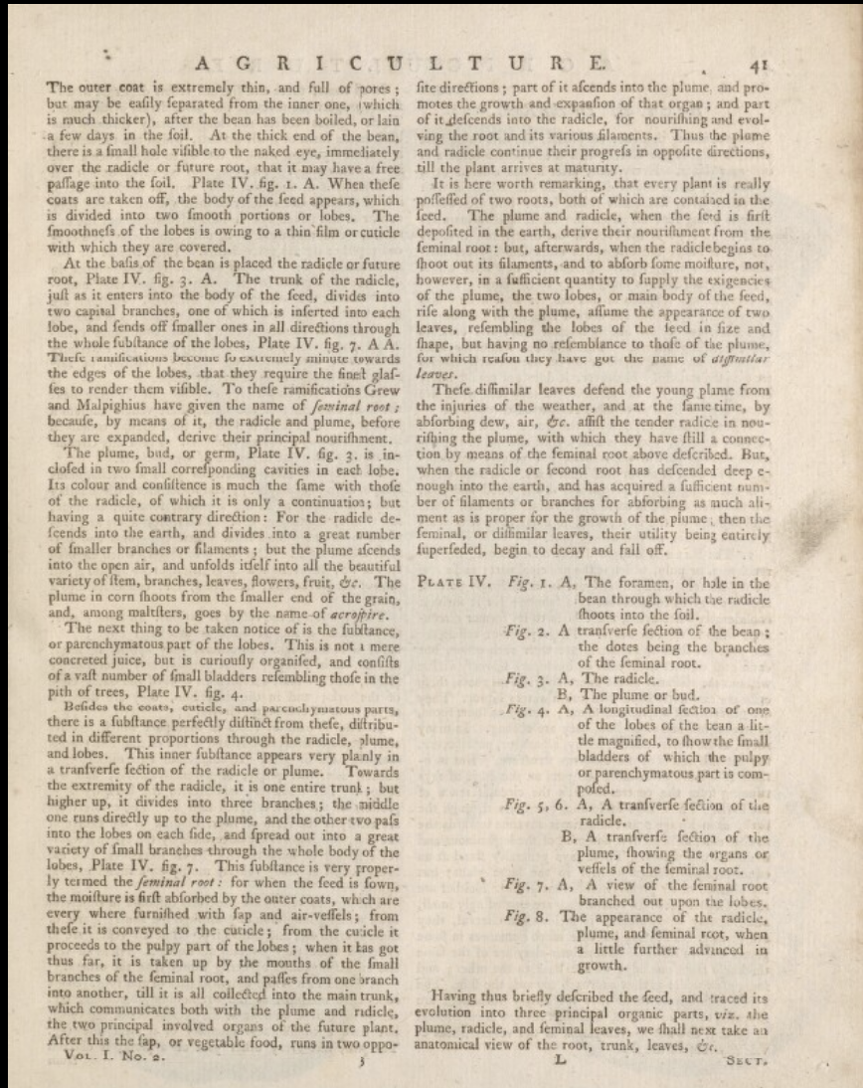
1. Detecting pages headers from ALTO XML
2. Using headers to classify terms into: Articles & Topics
3. Using ALTO Text for detecting the start of each article:
--> Starting a line with TERM UPPERCASE + “,”
Phase 1: Information Extraction
Articles
Topic
Edition 1 - 1771

Slide 10
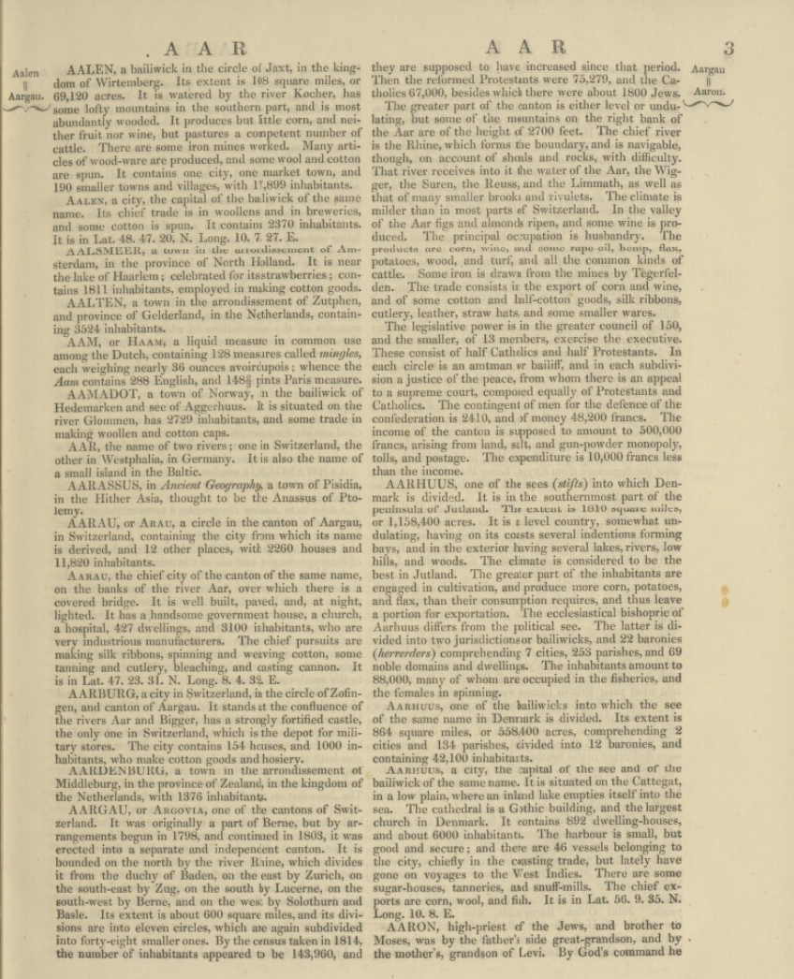
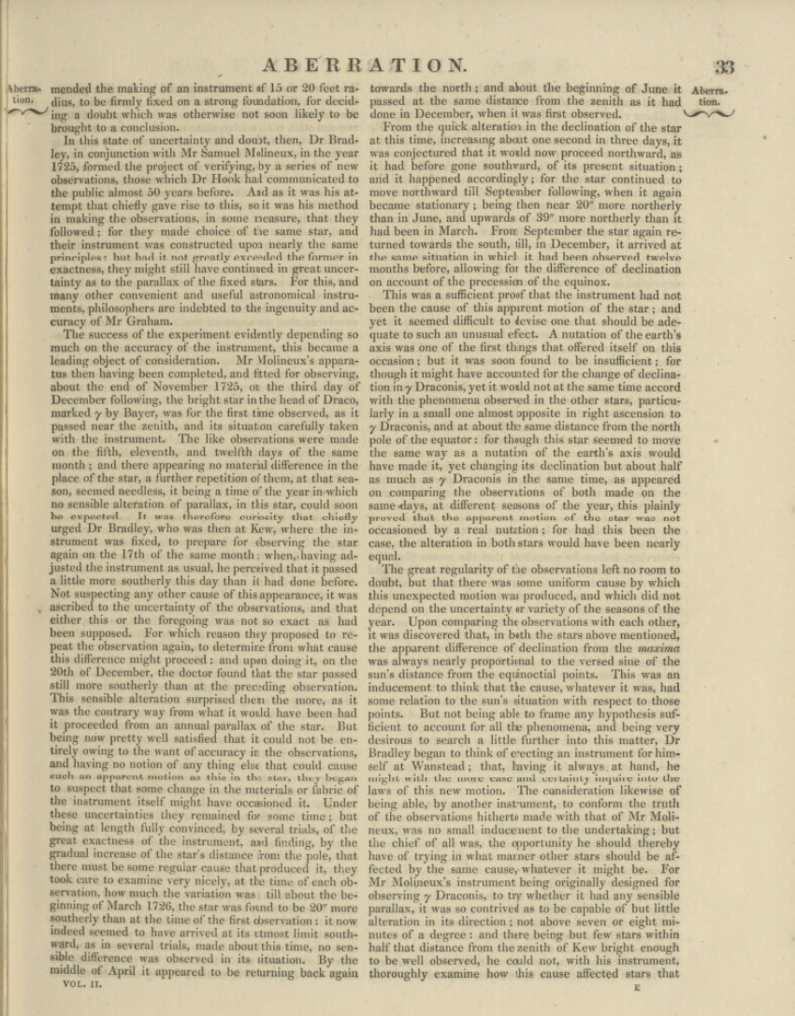
1. Detecting pages headers from ALTO XML
2. Using headers to classify terms into: Articles & Topics
3. Using ALTO Text for detecting the start of each article:
--> Starting a line with TERM UPPERCASE + “,”
Phase 1: Information Extraction
Articles
Topic
Edition 7

Slide 11
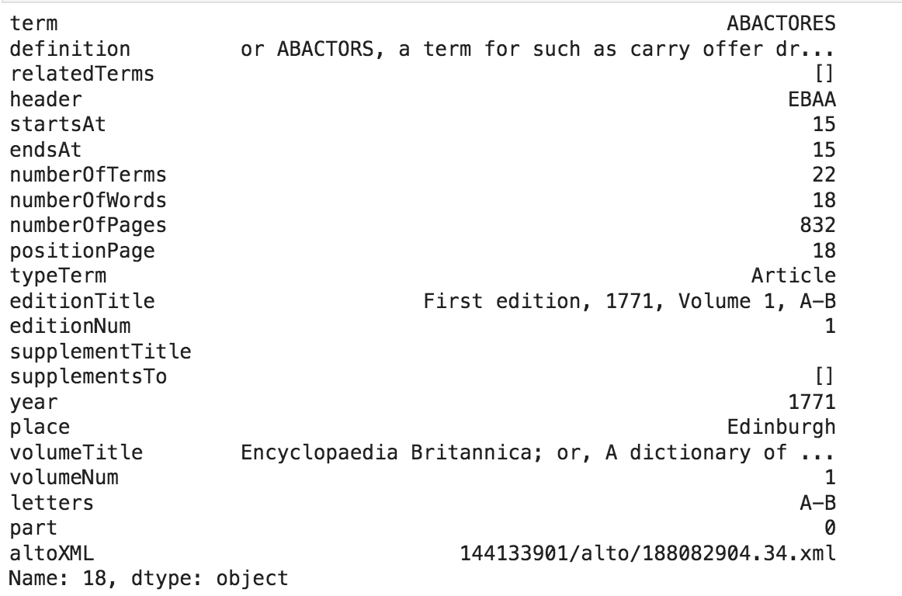
Extract EB Terms
Extracted Term ABACATORES information - Edition 1, 1771, Vol A-B

Slide 12
Phase 1: Information Extraction
1.2 Improved defoe Metadata Extraction query → It extracts the metadata per Edition and Volume (Metadata v.1) → Based on METS information
Note: Supplements have a slightly different metadata information.

Slide 13
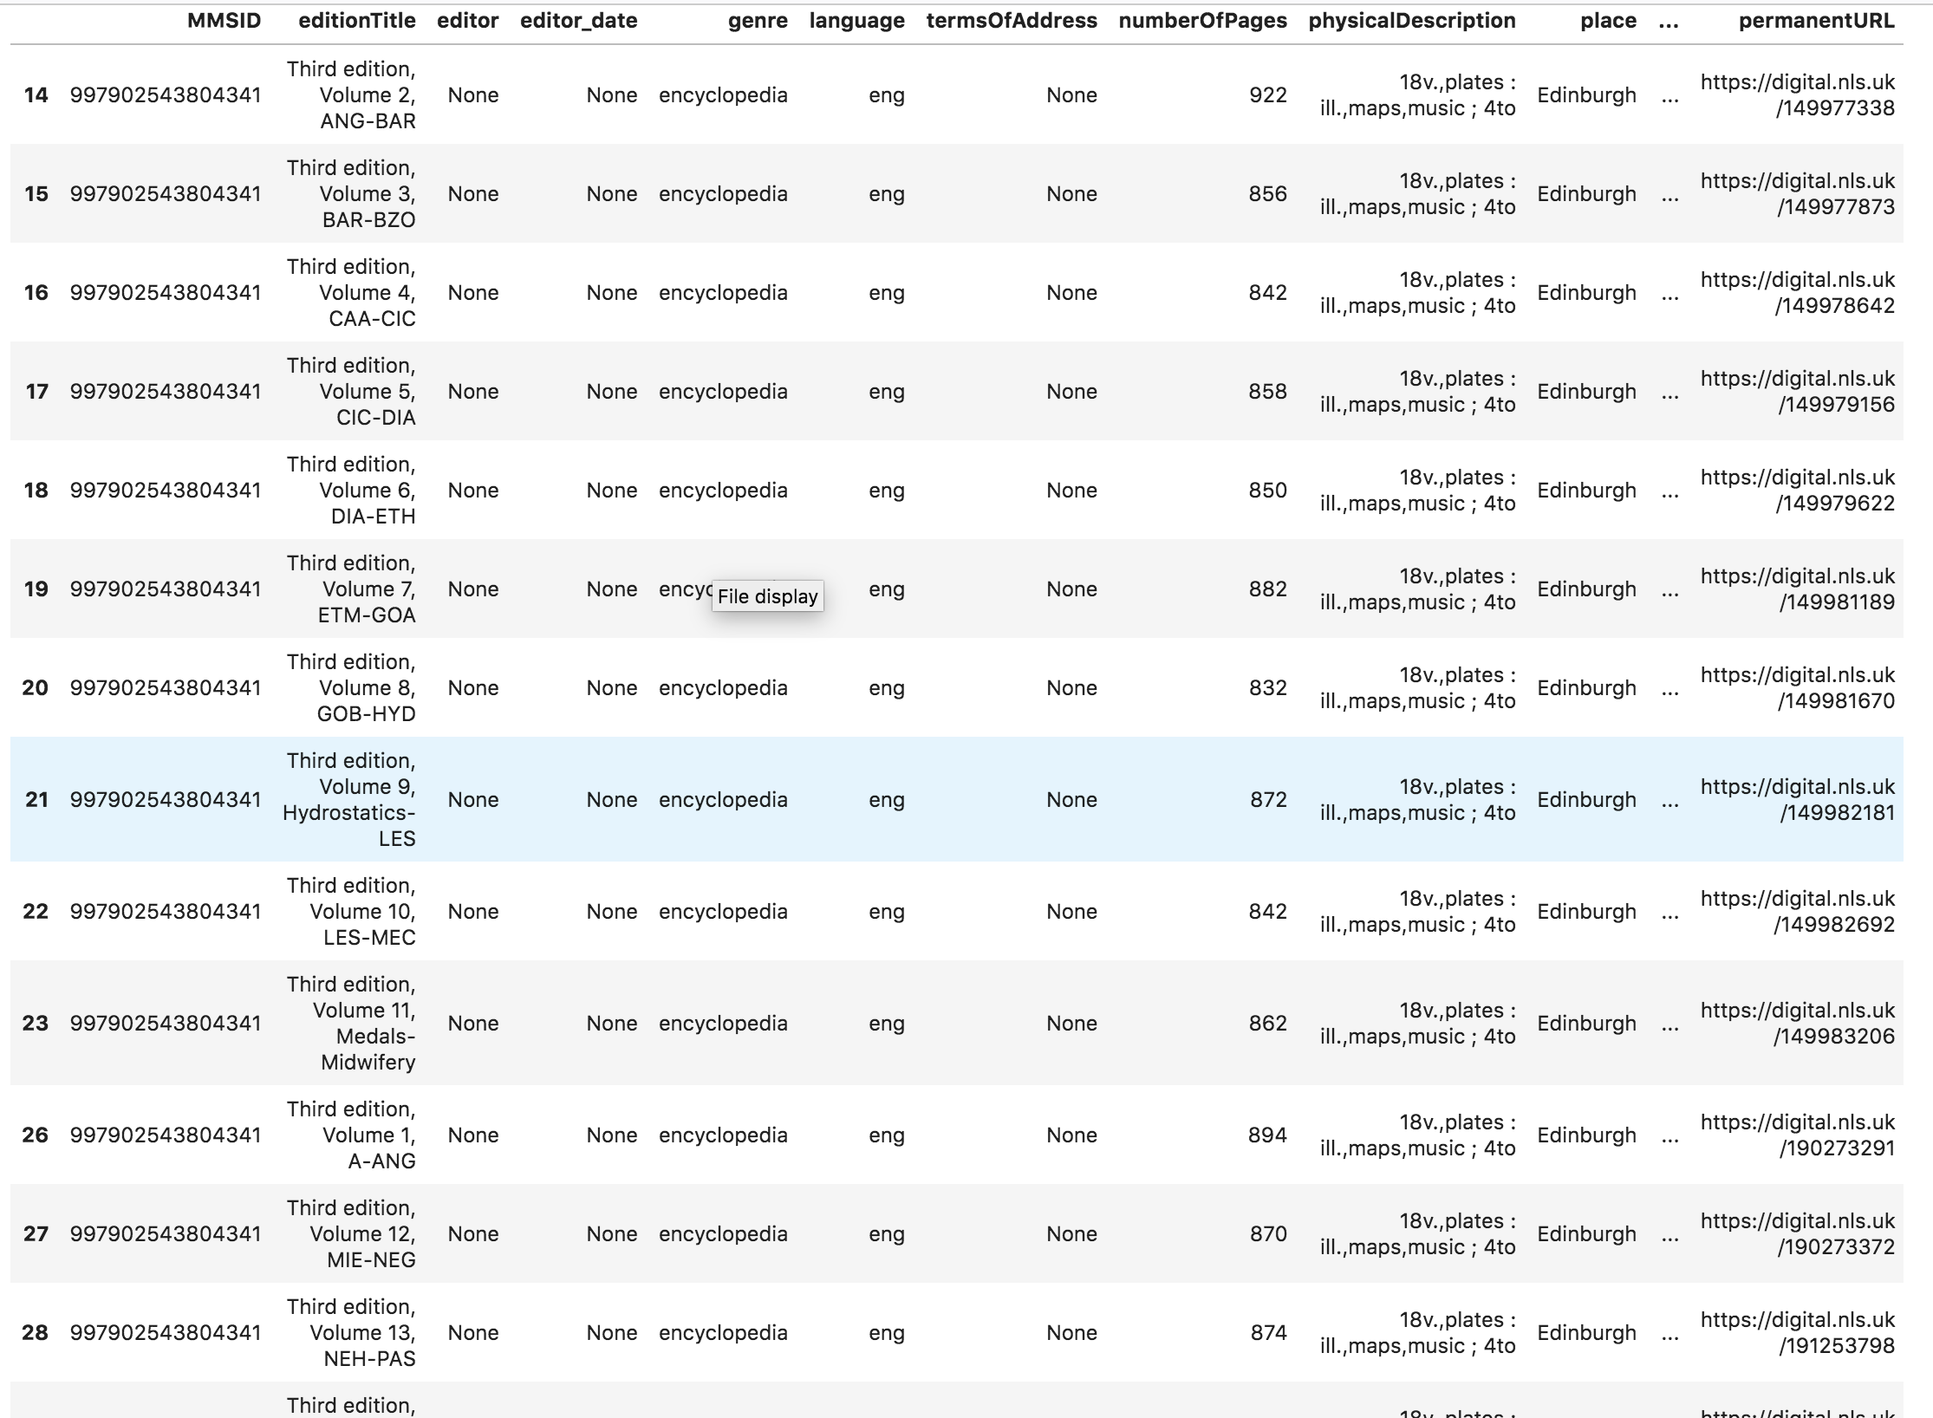
Extract collection Metadata
… more
metadata
columns
Extracted Metadata of some of the Volumes of Edition 3

Slide 14
Phase 1: Information Extraction
1.3. New Post-processing python scripts (*) to improve the previous results:
- Re-classification of Terms v.1 (articles and topics)
- Join terms split across pages
We get here: Terms & Metadata v.2
(*) Also Based on Heuristics --> Pages Layout & Text & Headers → different heuristics for different EB editions.

Slide 15
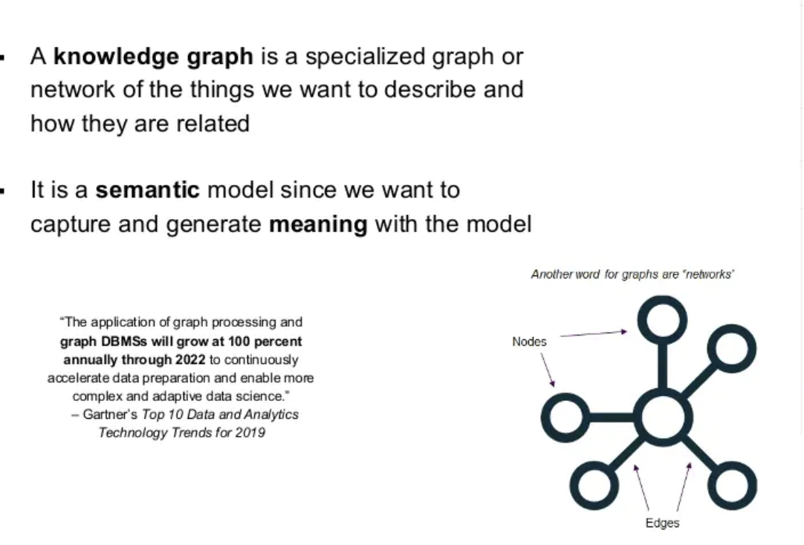
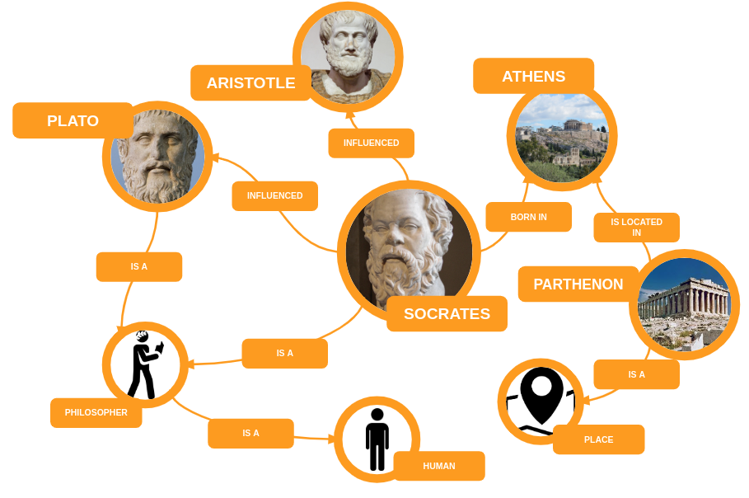
Phase 2: Knowledge Graph
Knowledge Graph: Incorporate human knowledge into intelligent systems, exploiting a semantic graph perspective

Slide 16
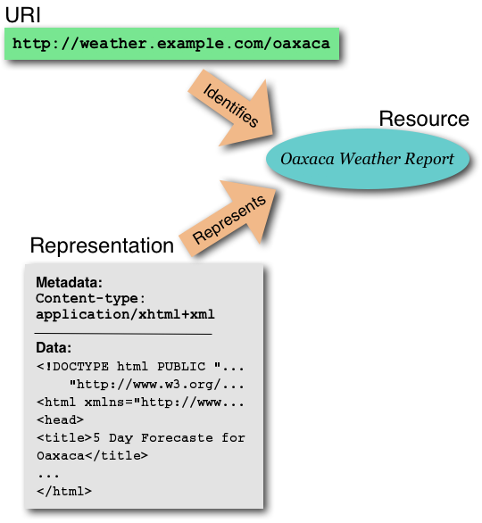
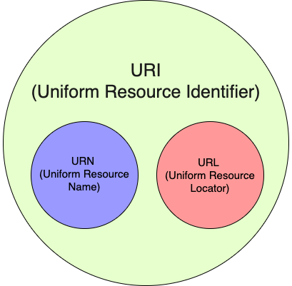
Phase 2: Knowledge Graph
Knowledge Graph: Incorporate human knowledge into intelligent systems, exploiting a semantic graph perspective
URI: A Universal Resource Identifier, is defined to be an ASCII string used to identify “things” on the Knowledge Graph

Slide 17
Phase 2: Knowledge Graph
Knowledge Graph: Incorporate human knowledge into intelligent systems, exploiting a semantic graph perspective
2.1. Create EB Ontology: To explain (give meaning) how our “things” are related with each other.
In order to create and publish the EB-Ontology I used:
diagrams.net : To create an UML with the EB information (classes, properties, relationships, etc.)
Chowlk : To convert the UML into an OWL ontology
Widoco: To publish and create an enriched and customized documentation of the ontology
w3id.org: To configure my permanent Identifier for EB ontology
EB-Ontology : https://github.com/francesNLP/EB-ontology

Slide 18
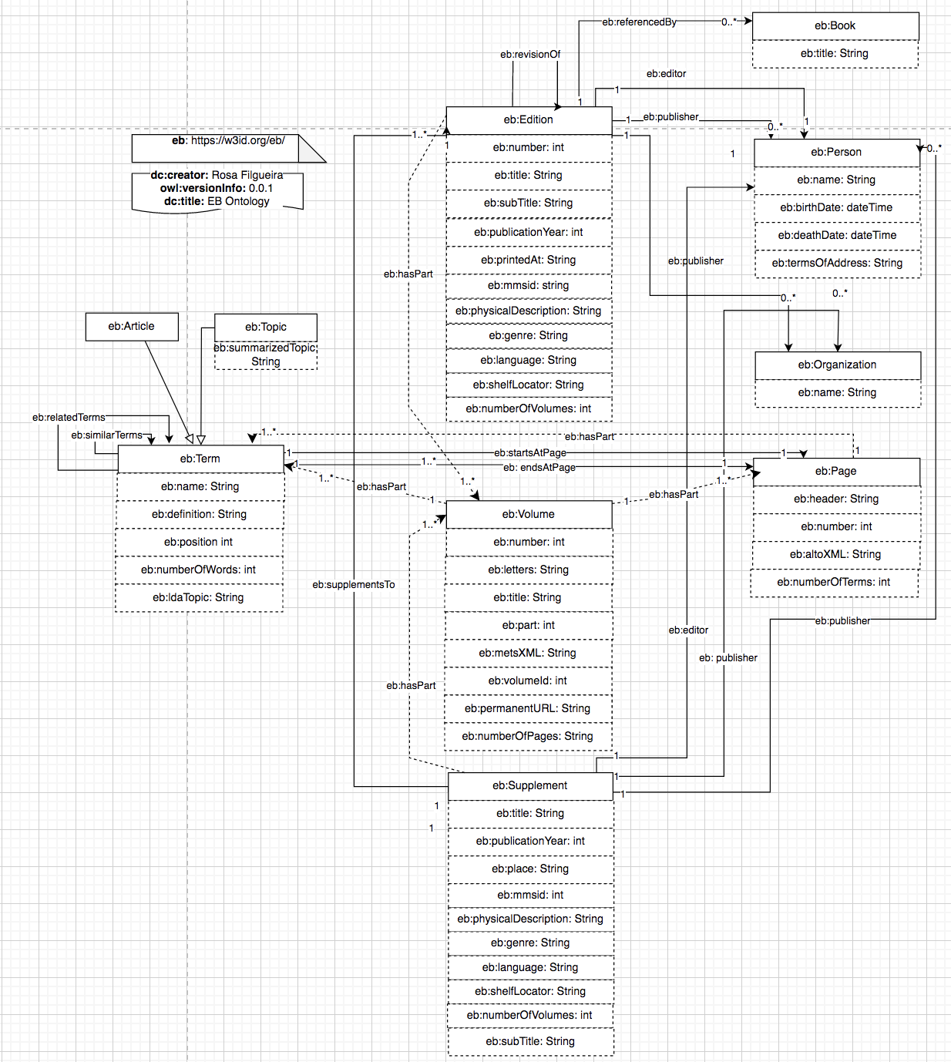
https://w3id.org/eb

Slide 19
Phase 2: Knowledge Graph
Knowledge Graph: Incorporate human knowledge into intelligent systems, exploiting a semantic graph perspective
2. 2 Created EB Knowledge Graph 1.0: Populated the post-processed information (extracted Terms & Metadata v.2) into an RDF triplestore:
- Apache Jena FUSEKI SPARQL server
- Used this Fuseki-docker image to set up my SPARQL server/end-point
NOTE:
Each Term, Edition, Page, Volume, etc … is a Resource in our Knowledge Graph
and has an URI to identify it.

Slide 20
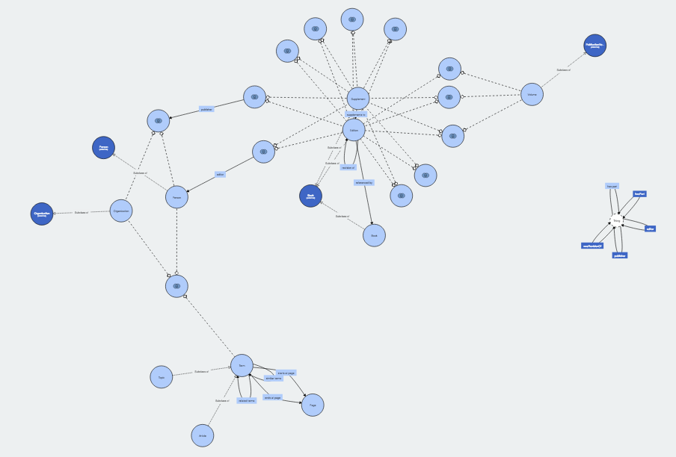
EB Knowledge Graph

Slide 21
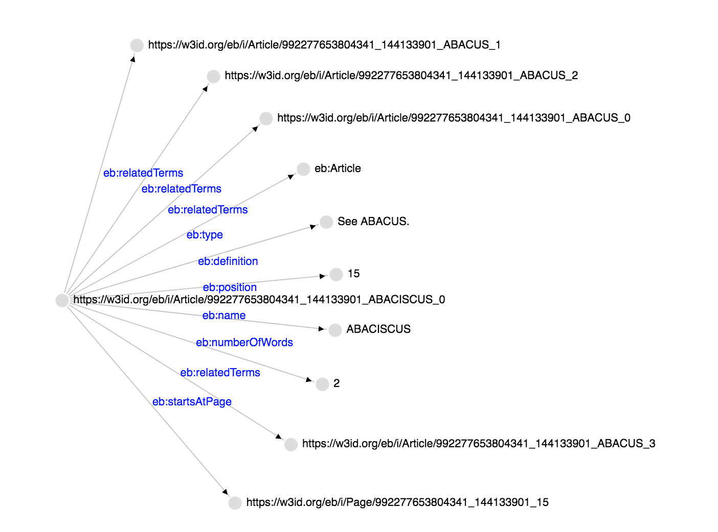
EB Knowledge Graph
Term ABACISCUS, URI: https://w3id.org/eb/i/Article/992277653804341_144133901_ABACISCUS_0

Slide 22
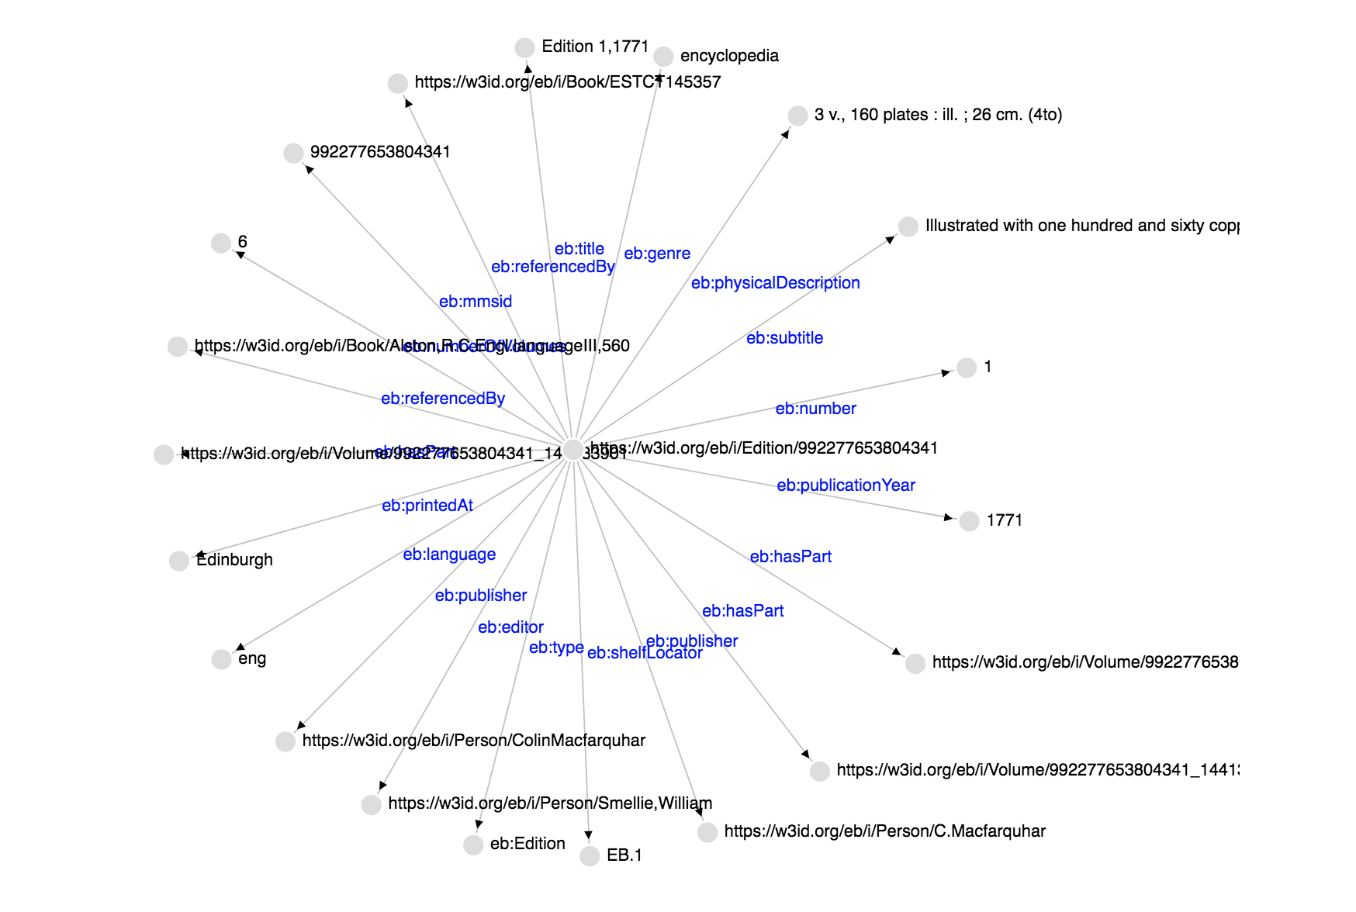
EB Knowledge Graph
Edition 1, 1771 – URI: https://w3id.org/eb/i/Edition/992277653804341

Slide 23
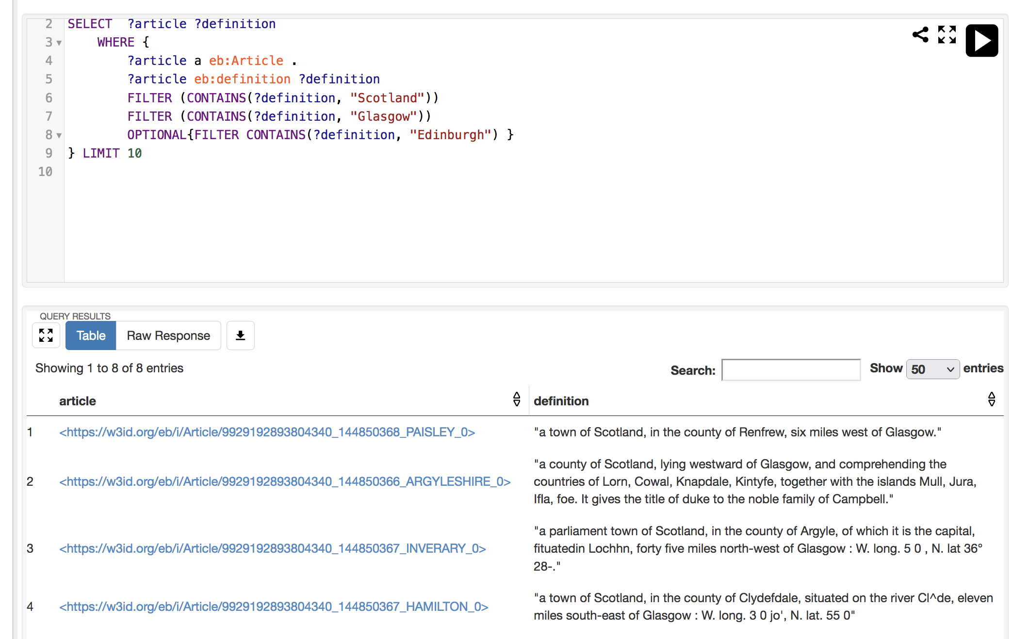
EB Knowledge Graph – Querying our KG
SPARQL is an RDF query language—that is, a semantic query language for databases—able to retrieve
and manipulate data stored in Resource Description Framework (RDF) format.
Fuseki RDF triplestore

Slide 24
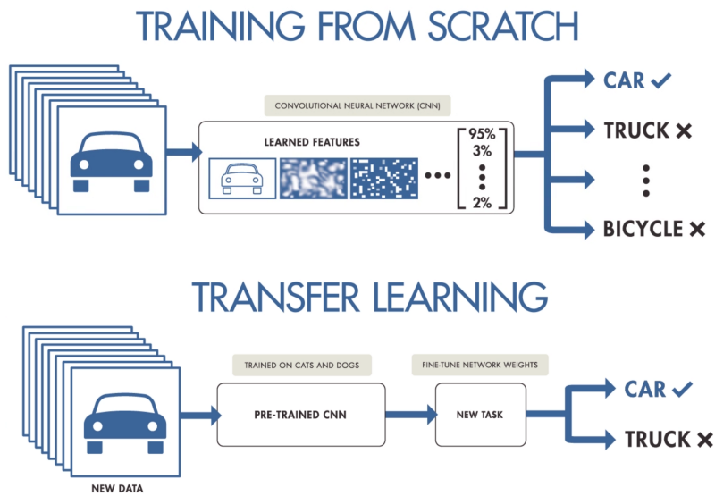
Phase 3: Augmented Knowledge Graph with Deep Transfer Learning
We are going to use this approach for applying NLP/ML analysis

Slide 25
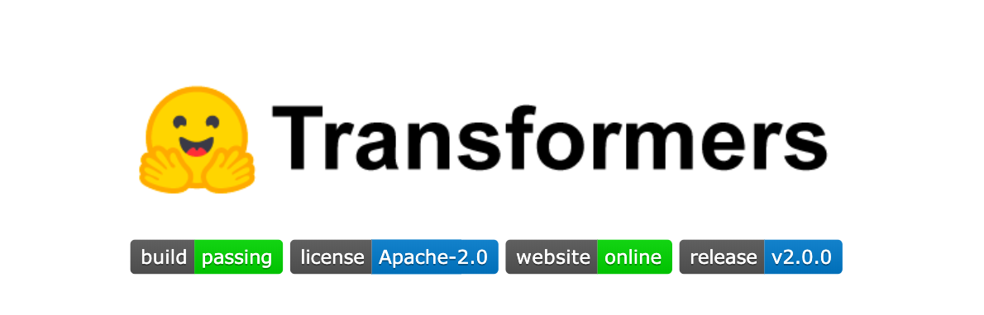
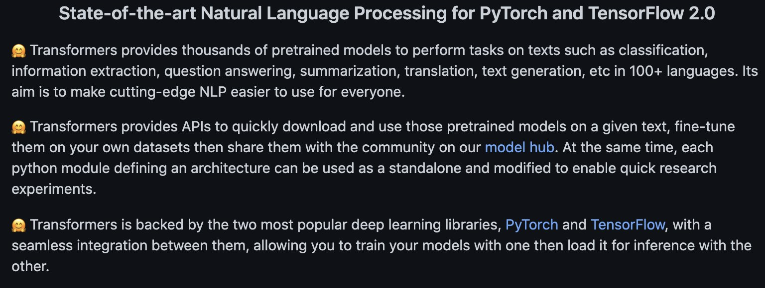
Phase 3: Augmented Knowledge Graph with Deep Transfer Learning

Slide 26
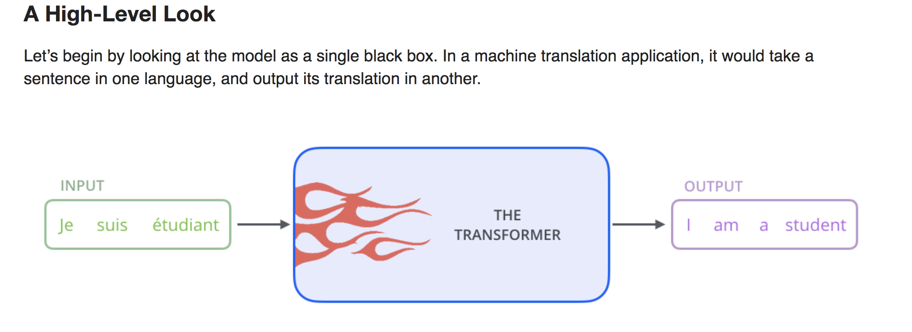
Phase 3: Augmented Knowledge Graph with Deep Transfer Learning

Slide 27
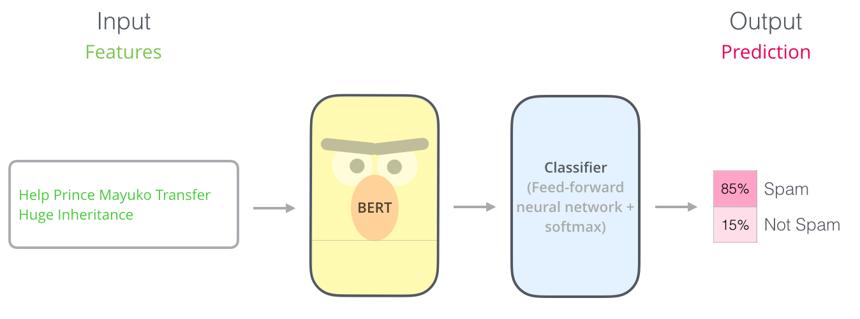
Phase 3: Augmented Knowledge Graph with Deep Transferring Learning
EB Knowledge Graph 2.0: previous info + storing the result of applying different deep learning transformers analyses:
Transfer Learning:
We have not built the
model/transformer

Slide 28
Phase 3: Augmented Knowledge Graph with Deep Transferring Learning
EB Knowledge Graph 2.0: previous info + storing the result of applying different deep learning transformers analyses:
- sentiment analyses: Classifying text between positive and negative - transformer: siebert/sentiment-roberta-large-english
- topic modelling: Clustering terms into topics
– transformer: all-mpnet-base-v2
- term similarity: Comparing text & semantic similarity
- transformer: all-mpnet-base-v2
- spelling checking: Finding misspelling/ocr errors and fixing them
- transformer: neuspell + ElmosclstmChecker
- term evolution: Checking how a term has changed over the years
– transformer: all-mpnet-base-v2
- summarization: Summarizing the text of a topic term (XLNET)
– transformer: XLNeT
Note: Using pre-training models to calculate those analyses

Slide 29
Phase 3: Augmented Knowledge Graph with Deep Transferring Learning
EB Knowledge Graph 2.0: previous info + storing the result of applying different deep learning transformers analyses:
- sentiment analyses: Classifying text between positive and negative
- topic modelling: Clustering terms into topics
- term similarity: Comparing text & semantic similarity
- spelling checking: Finding misspelling/ocr errors and fixing them
- term evolution: Checking how a term has changed over the years
- summarization: Summarizing the text of a topic term
Example: Spelling Checking → Lewis Term
Cleaned Definition
Compute Difference

Slide 30
Phase 3: Augmented Knowledge Graph with Deep Transferring Learning
Two types of “queries” to run against the EB Knowledge Graph 2.0 :
Type 1: Extracting information from the EB Knowledge → SPARQL → We “just” navigate through the KG to get the desired information.
Example: Given a Term ( e.g., Edinburgh), I can get the Edition Information (e.g., Edition Title)
Type 2: Processing information from the EB Knowledge → defoe → We are going to process further the definitions from the selected terms.
But for doing this we needed to do some work on defoe first → Phase 4
Term
Volume
Edition

Slide 31
Phase 4: Defoe and Knowledge Graph
4.1. Created a new KG defoe connector (based in SPARQL) to run defoe queries using the EB Knowledge Graph as a source of data → defoe_KG
4.2. Improved defoe queries to be fully configurable: different filtering options, target, lexicon, etc.
EB Knowledge Graph 2.0
defoe_KG
Configurations

Slide 32
Phase 4: Defoe and Knowledge Graph
4.3 defoe text mining queries:
frequency_keysearch: Count number of terms or times in which appear keywords or keysentences and group by years. Several filtering options.
term_fulltext_keysearch: Extract terms definitions in which appear keywords or keysentences and group by years. Several filtering options.
term_snippet_keysearch: Extract snippets of definitions in which appear keywords or keysentences and group by years. Several filtering options, including the snippet size.
publication_normalization: Extract the number of documents, pages, words per year.
uris_keysearch: Extract uris of terms in which appear keywords or keysentences and group by years. Several filtering options.
geoparser_terms: Geoparsing the term definition in which appear keywords or keysentences and group by years. Several filtering options.
EB Knowledge Graph 2.0
defoe_KG
Configurations

Slide 33
Phase 4: Defoe and Knowledge Graph
4.4 Created new defoe ML/NLP queries (using also deep learning transformers)
- sentiment analysis: Calculate the sentiment analyses of selected terms.
- topic modelling: Calculate the topic of selected terms. Filtering options.
- spelling checker: Check the spelling of selected terms. Filtering options.
(TO-DO)
EB Knowledge Graph 2.0
defoe_KG
Configurations

Slide 34
Phase 5: Flask Web-Application
5.1 Web-User Interface:
So, users DO NOT have to create SPARQL or defoe queries – the web-application does it for them ➔ Abstractions to SPARQL & DEFOE
The web-app runs both types of queries and visualizes the results
Functionalities:
- Term Search
- Term Similarity
- Topic Modelling
- Spelling Checker
- Defoe queries
- EB Details
- Knowledge Graph Resources Visualizations
5.2 Flask + JQuery + JavaScript + HTML + CSS + Web-services + Plotly

Slide 35
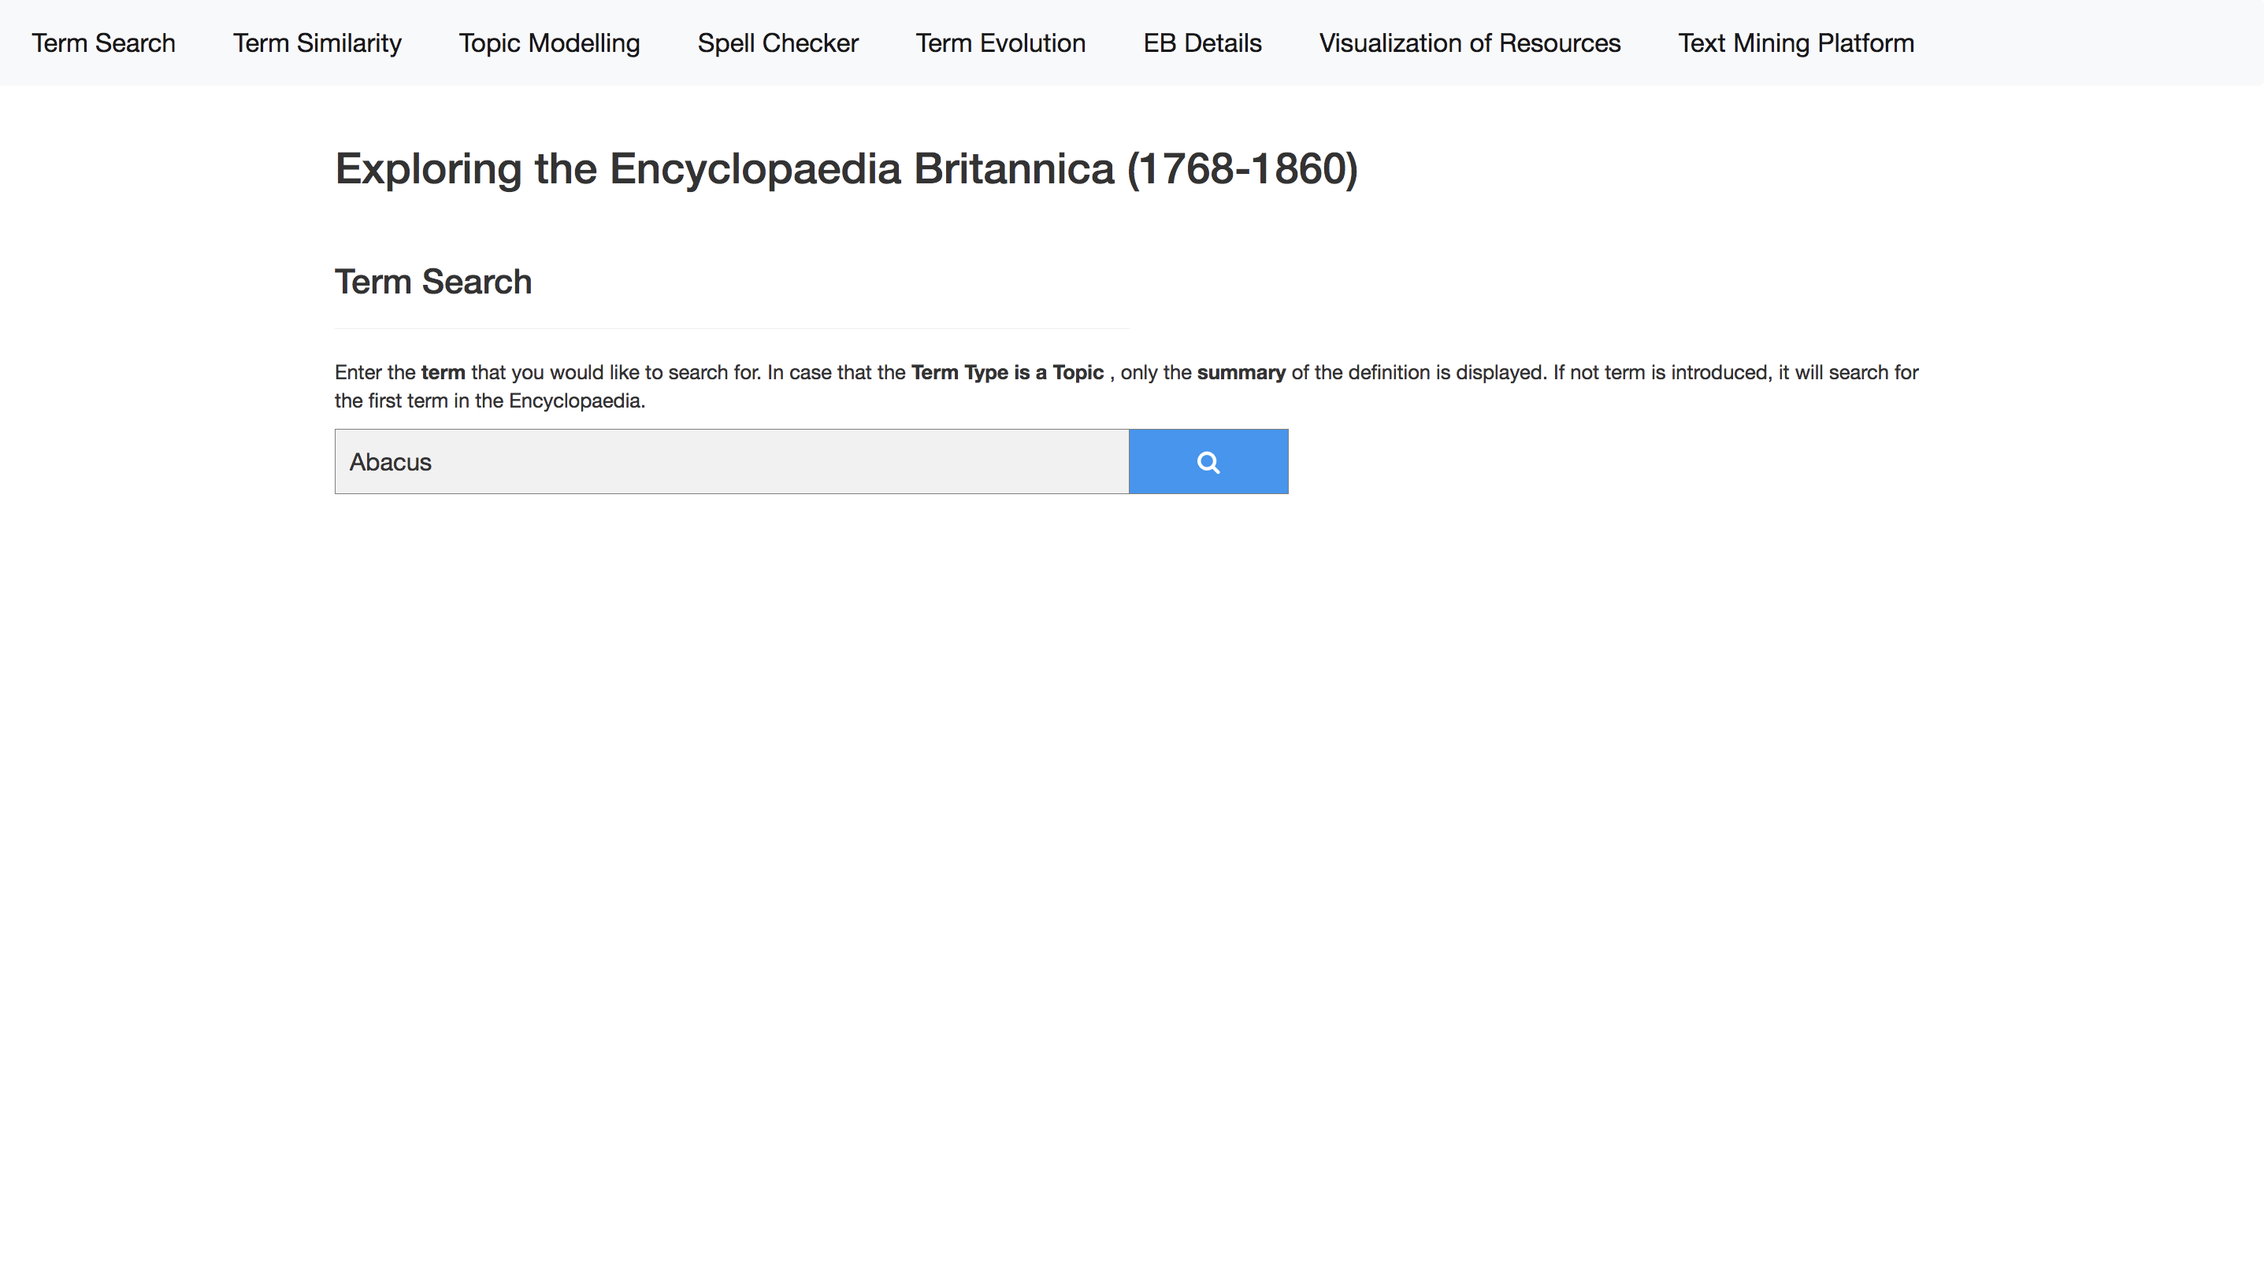
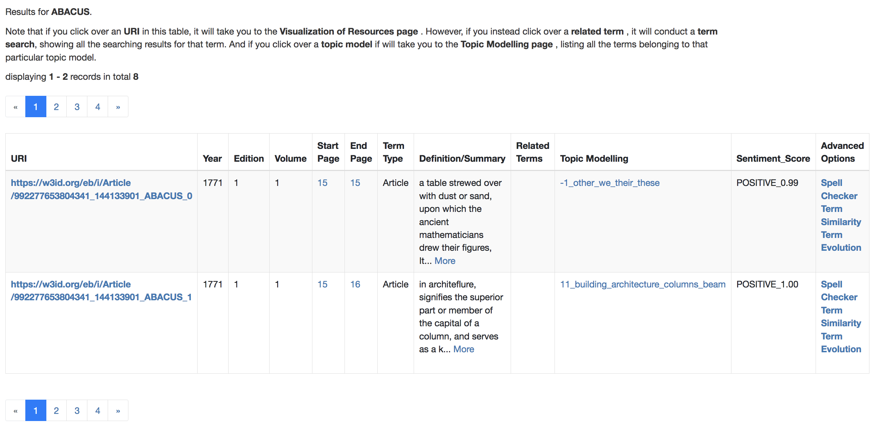
Interacting with the EB Knowledge Graph
FLASK Web-Application

Slide 36
Interacting with the EB Knowledge Graph
Type 1
Type 2
Note: Two types of EB-KG queries
- Type 1: Extracting information from EB-KG – Navigating across the KG – SPARQL queries
- Type 2: Processing information from EB-KG -- Processing in parallel further the Term’s definitions (stored in KG) – DEFOE queries

Slide 37
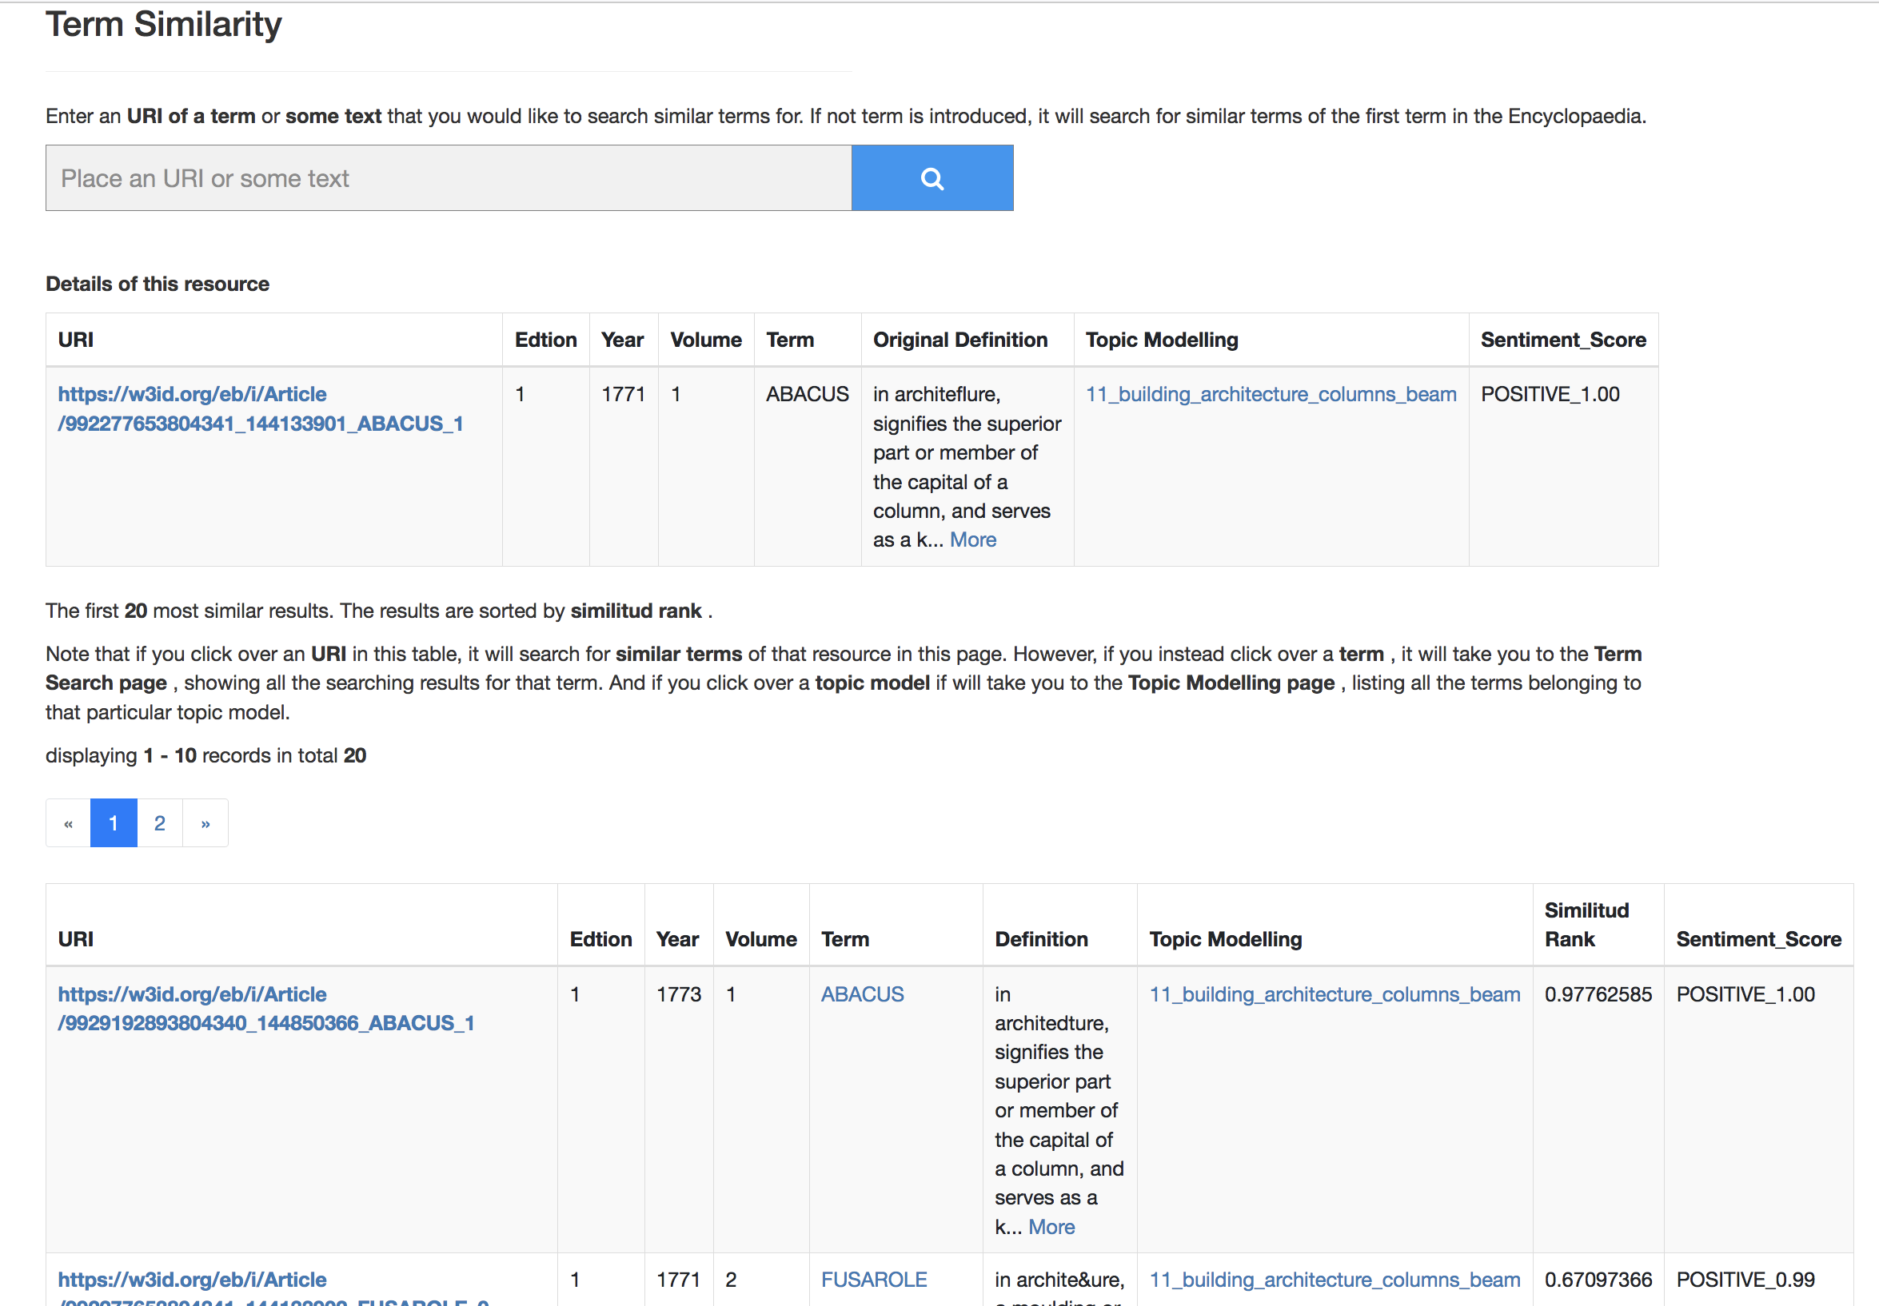
Interacting with the EB Knowledge Graph
Term Similarity

Slide 38
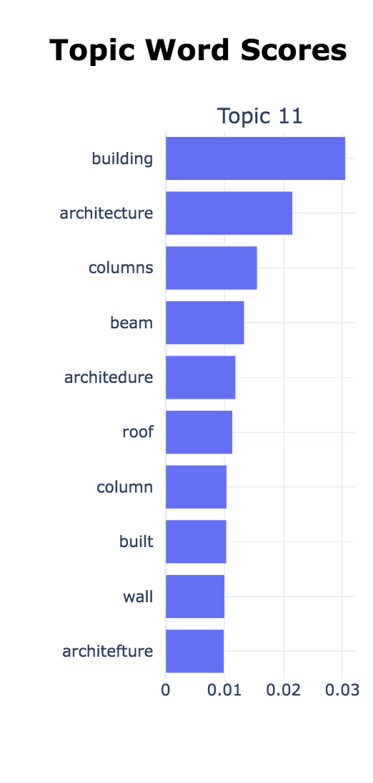
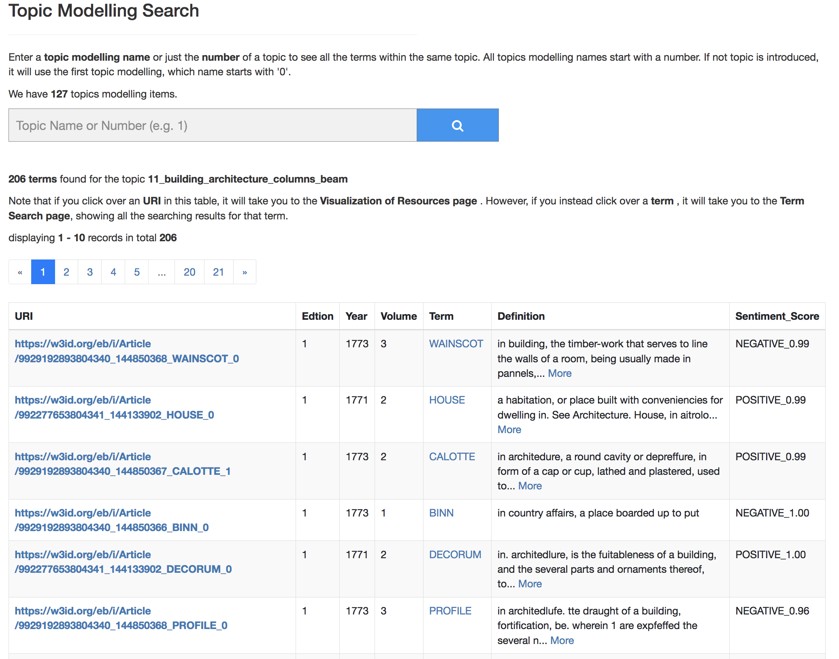
Interacting with the EB Knowledge Graph
Topic Modelling

Slide 39
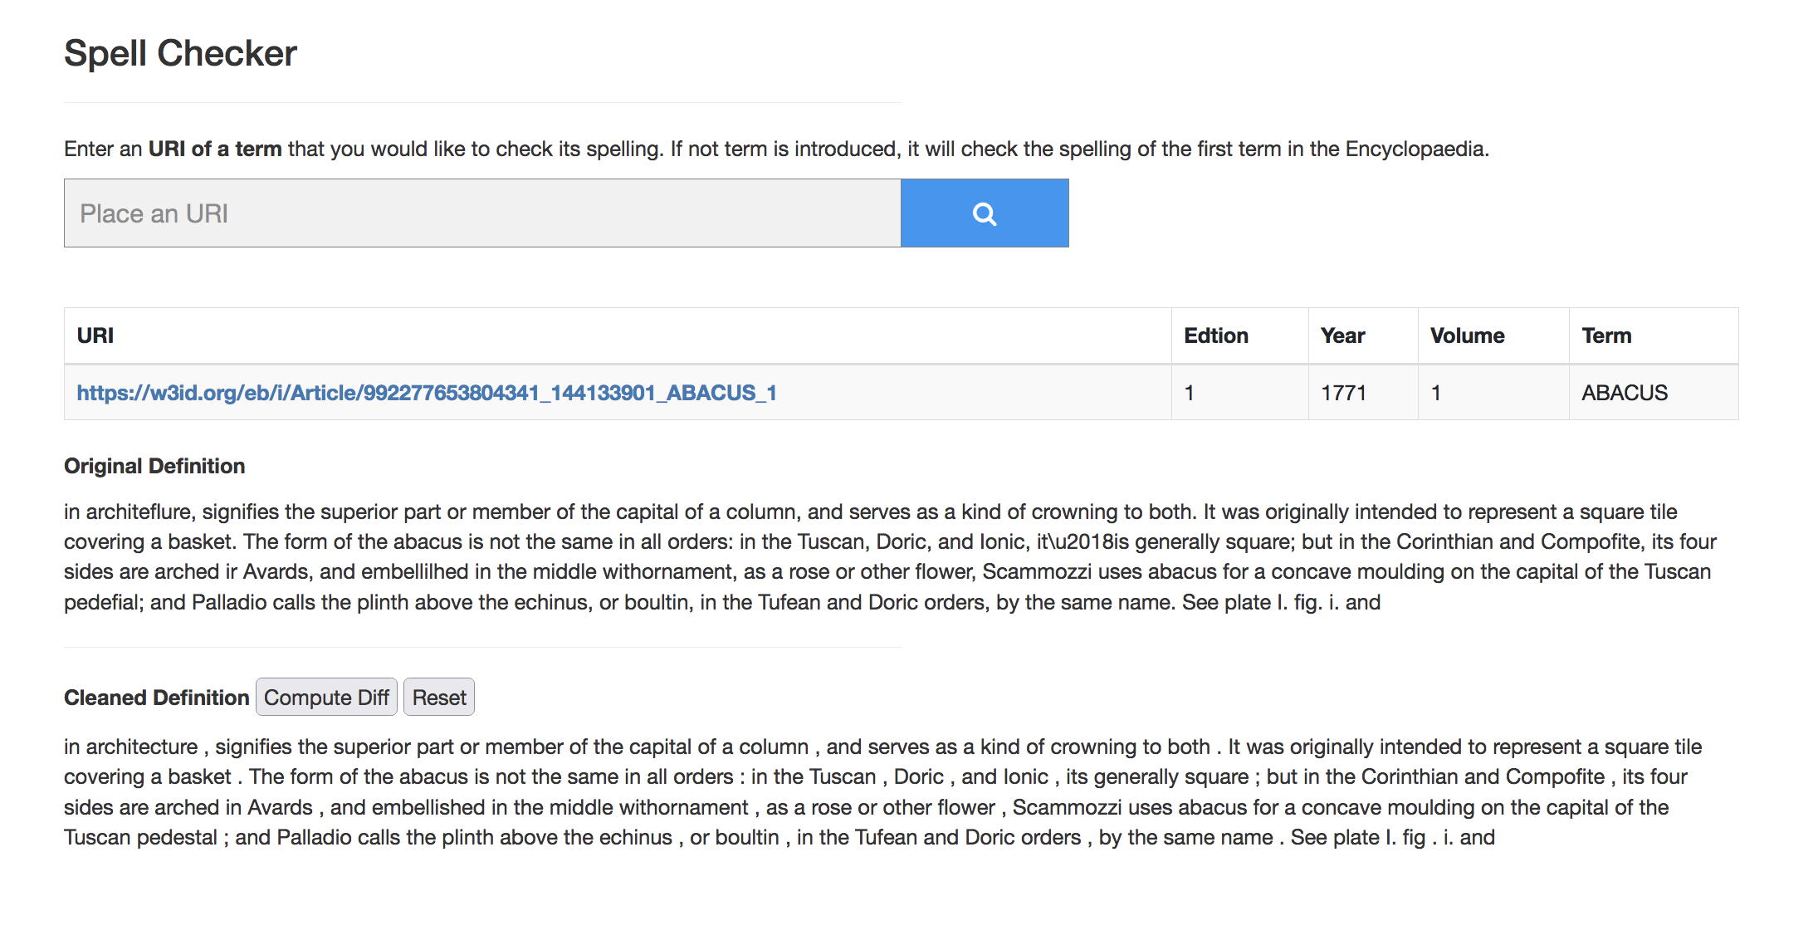
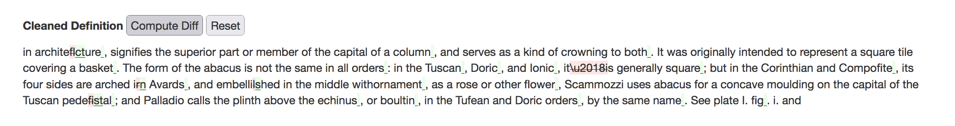
Interacting with the EB Knowledge Graph

Slide 40
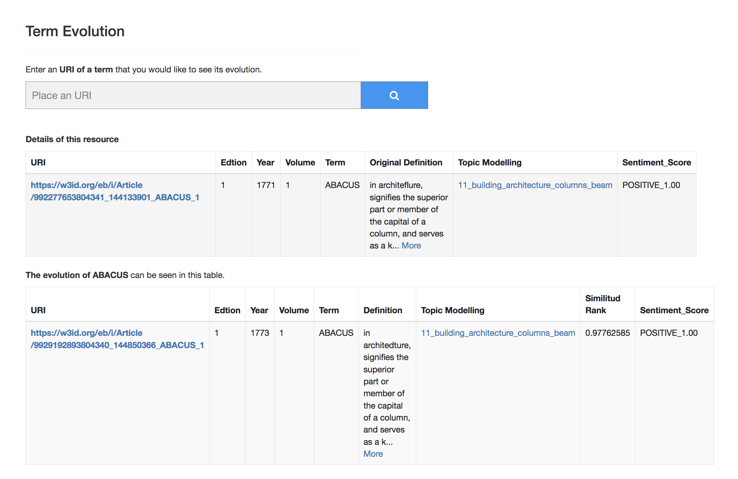
Interacting with the EB Knowledge Graph

Slide 41
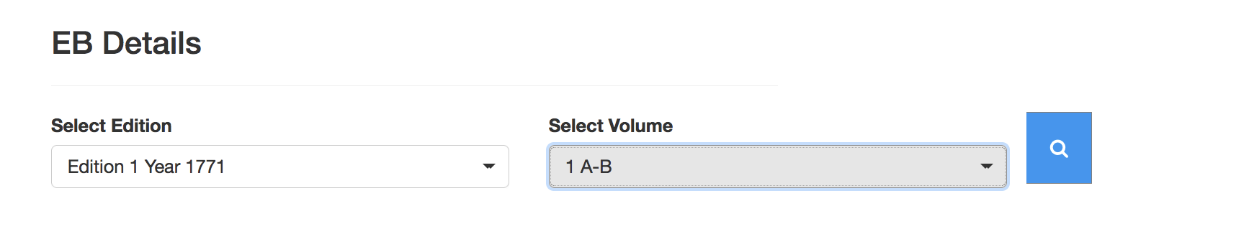
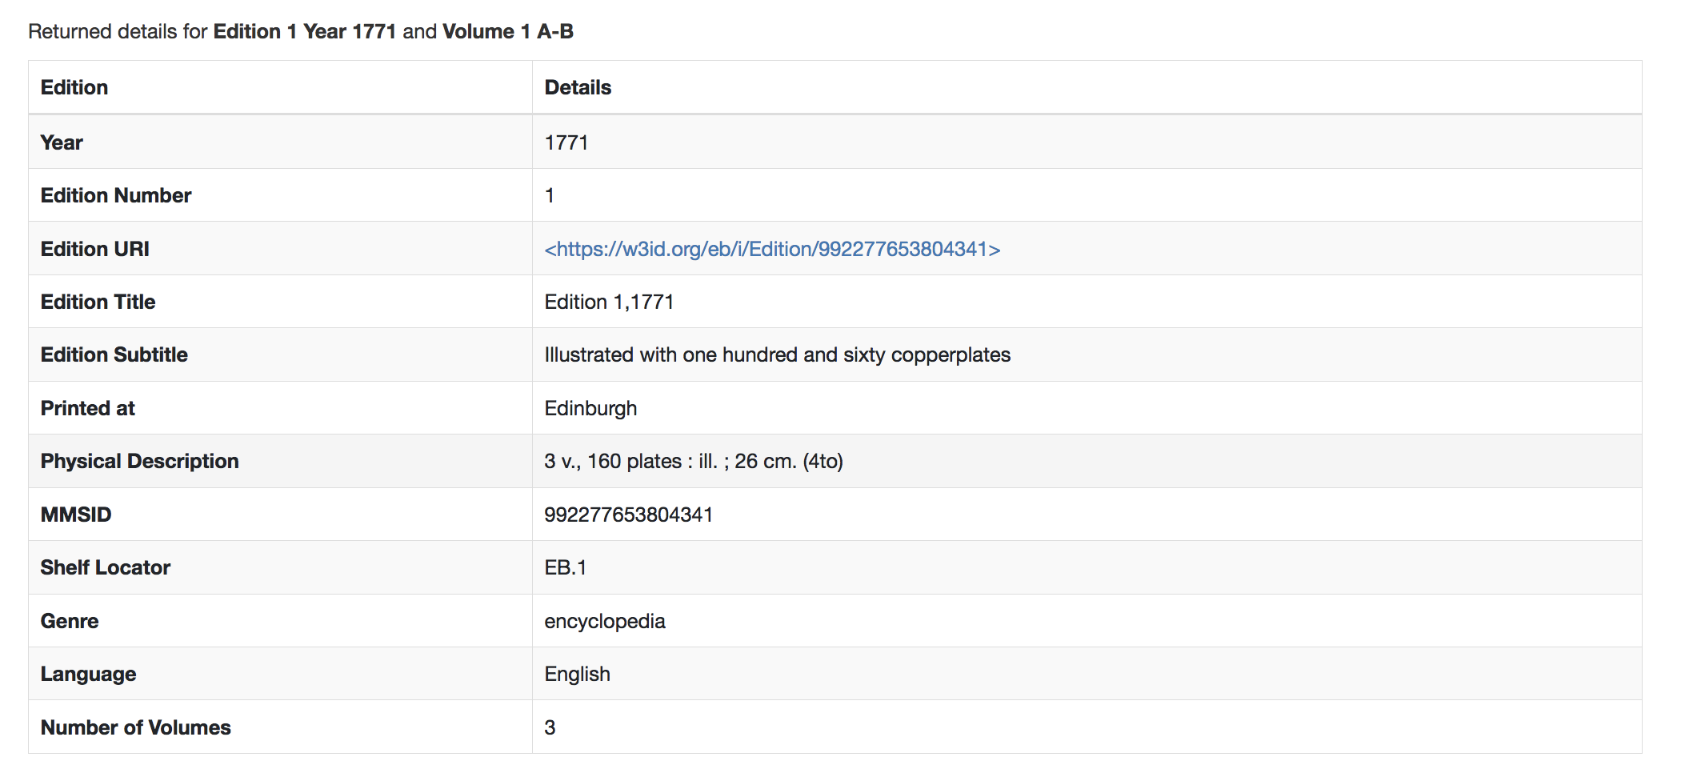
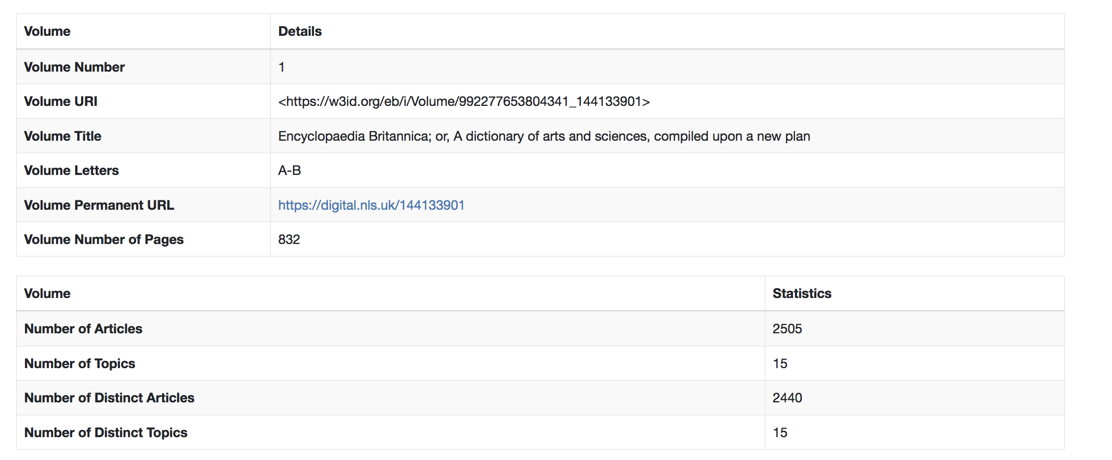
Interacting with the EB Knowledge Graph
Interacting with the EB Knowledge Graph

Slide 42
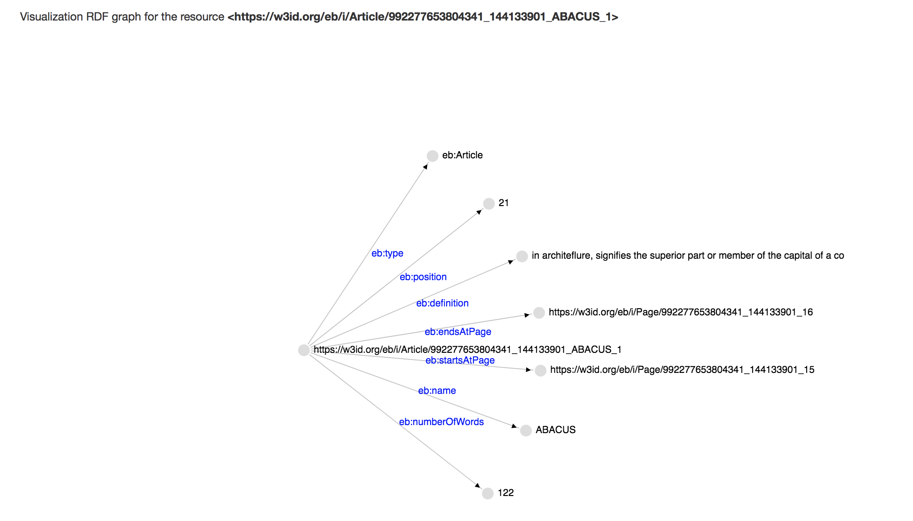
Interacting with the EB Knowledge Graph
Visualization of Resources

Slide 43
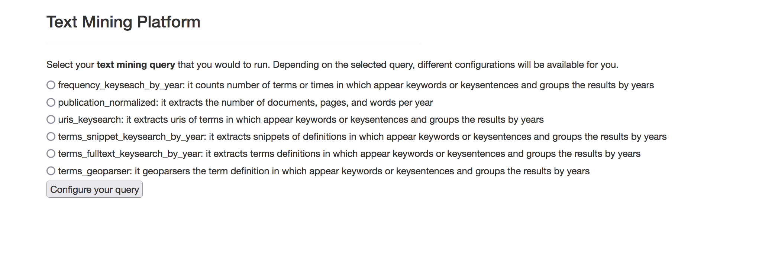
Interacting with the EB Knowledge Graph

Slide 44
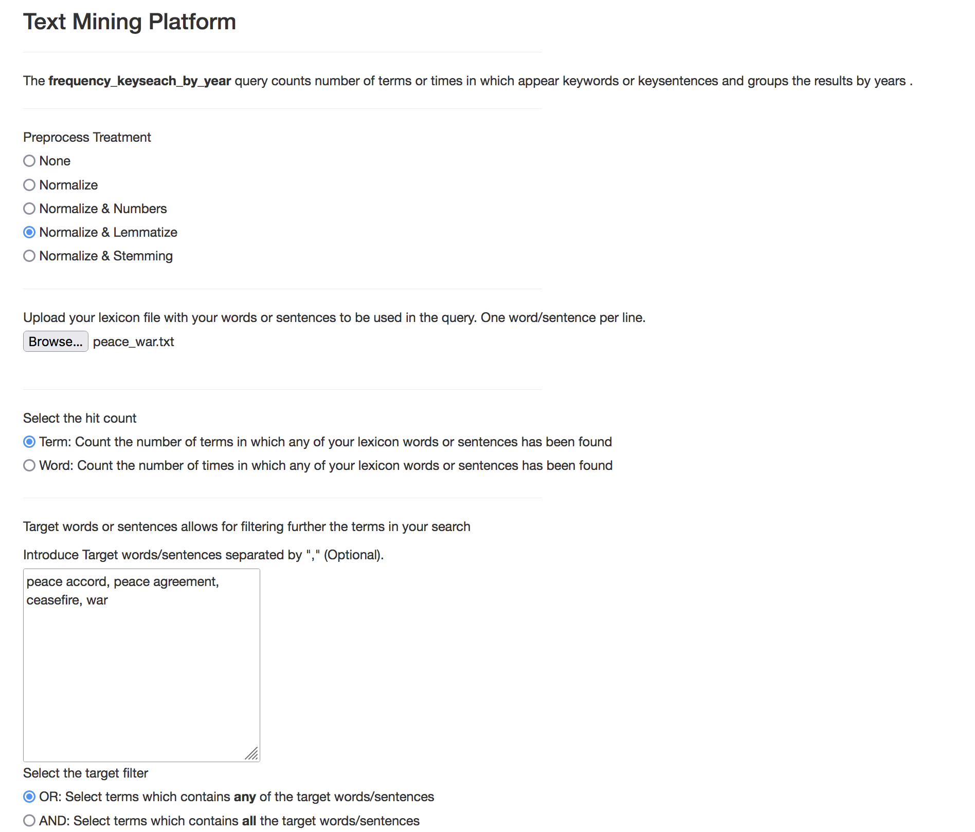
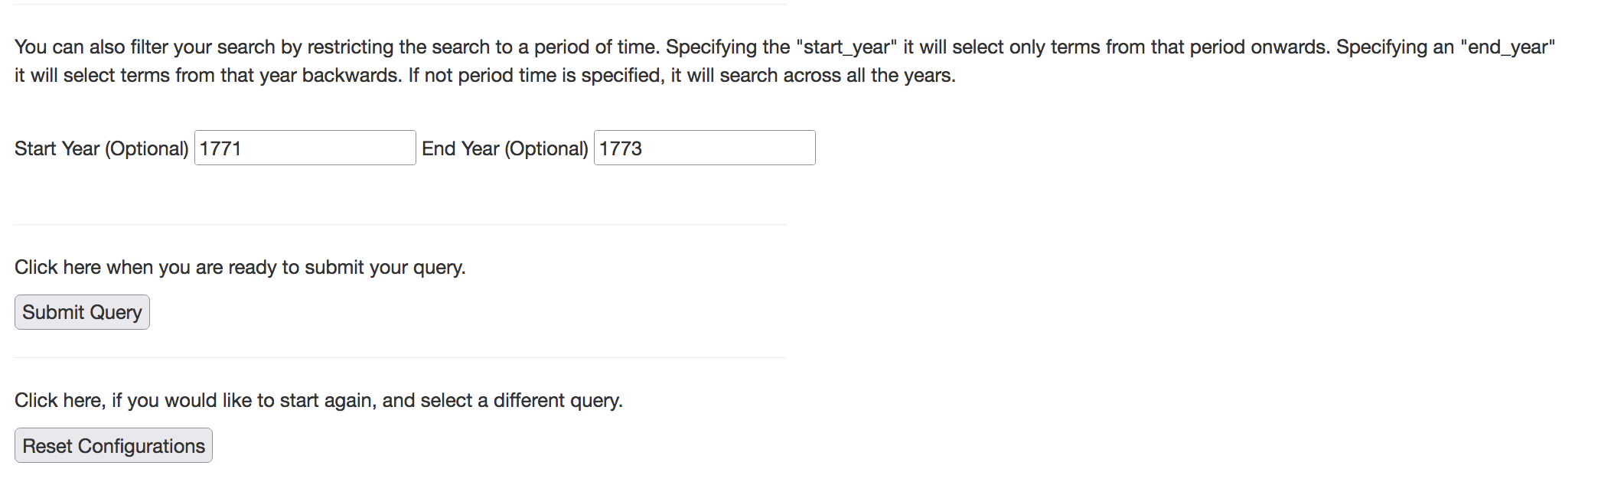
Interacting with the EB Knowledge Graph
Example 1

Slide 45
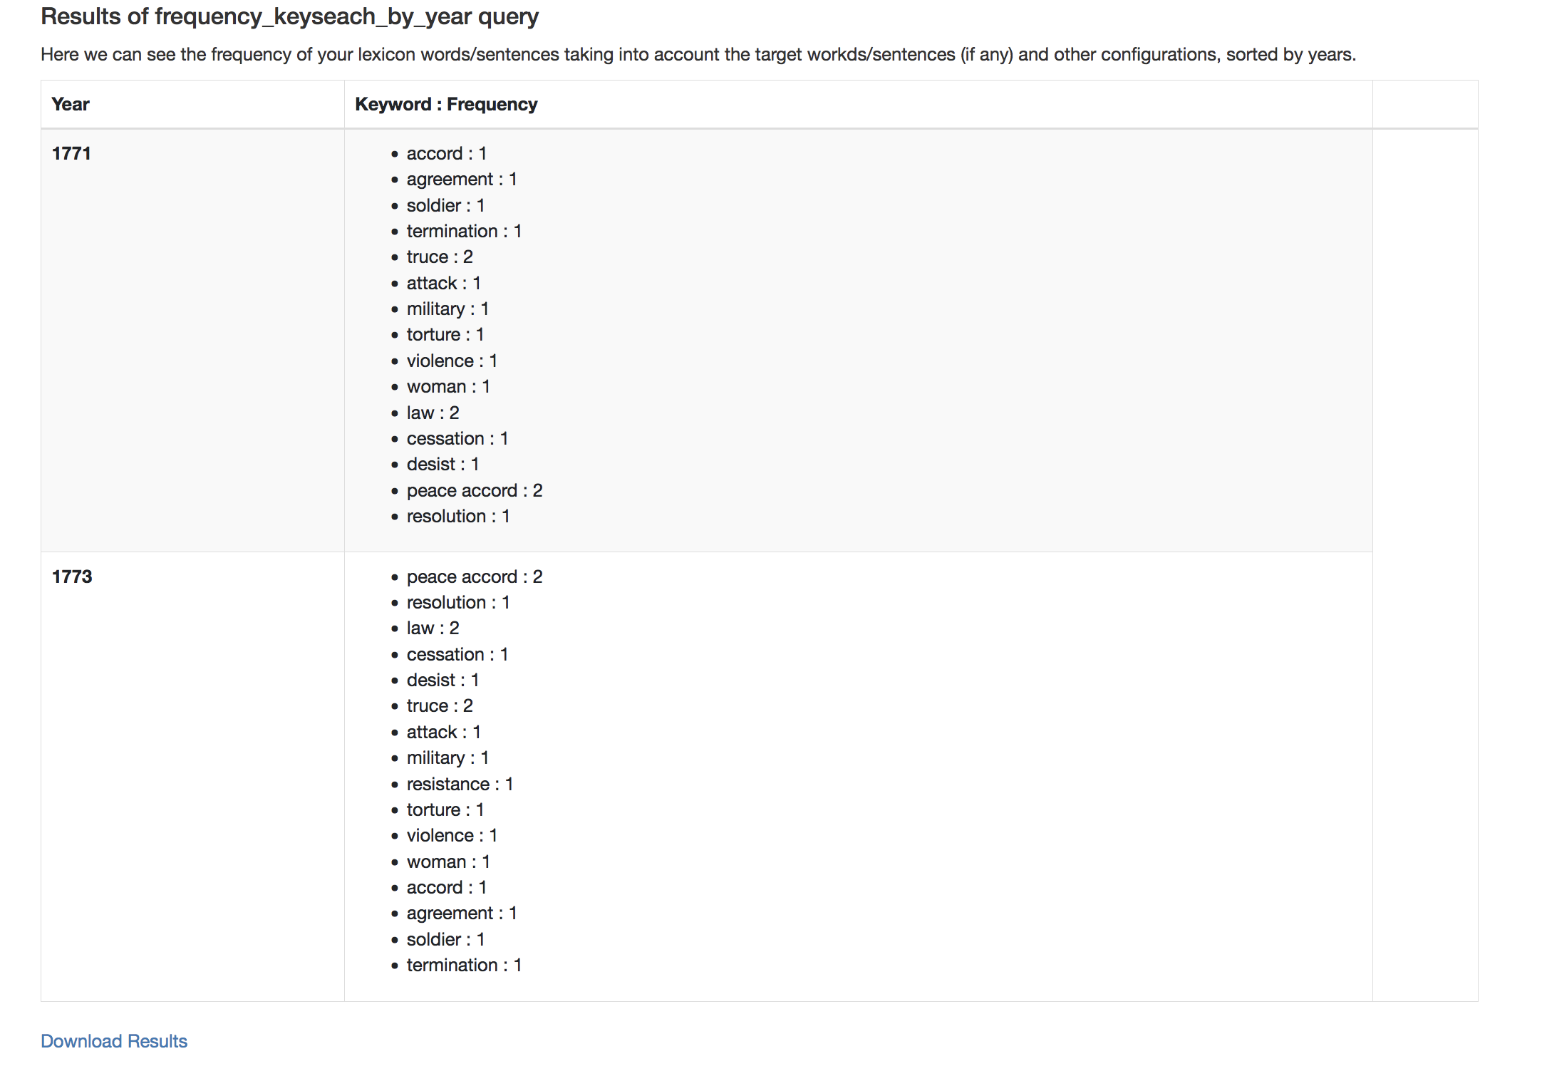
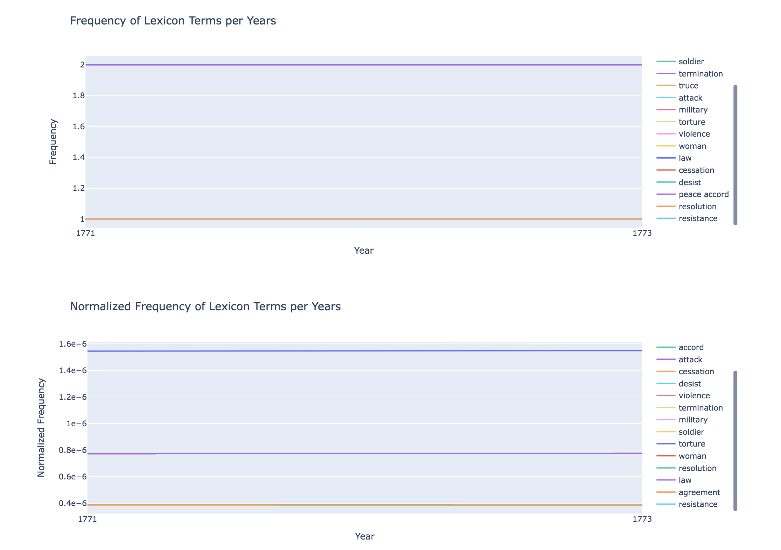
Interacting with the EB Knowledge Graph
Example 1

Slide 46
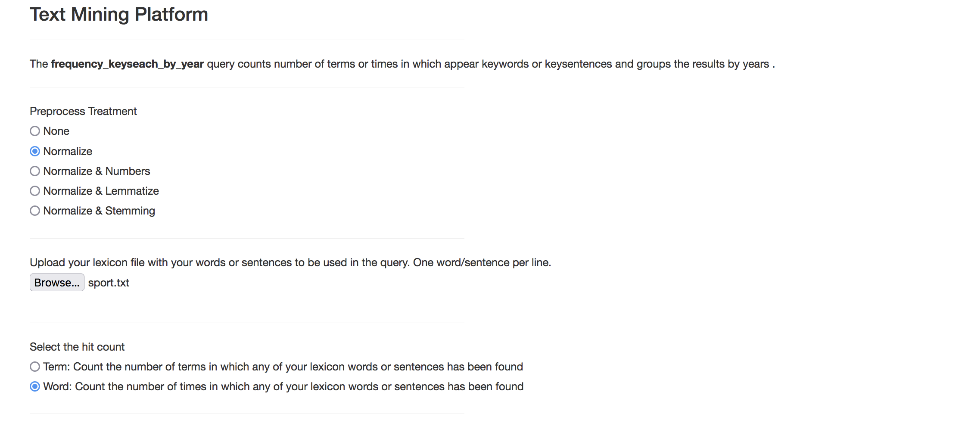
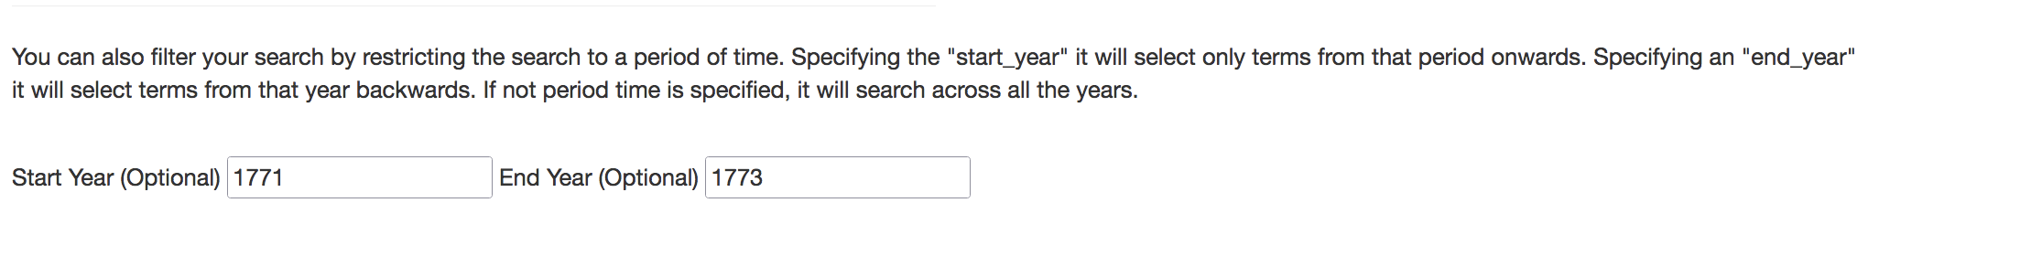
Interacting with the EB Knowledge Graph
Example 2

Slide 47
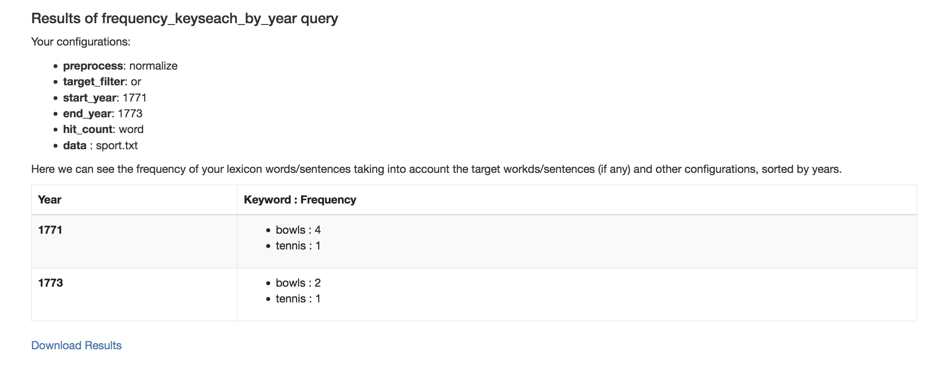




Interacting with the EB Knowledge Graph
Example 2

Slide 48



Interacting with the EB Knowledge Graph
Example 3

Slide 49
Architecture
NSL Data Foundry Collections
1
defoe
- Parallel XML ingestion
- NLP preprocessing pipeline
- Preliminary terms extraction
- Metadata extraction
EB
frances – Web-Application
2
Text-mining queries
ML/NLP queries: Term Search, Term Similarity, Topic Modelling, Spelling Checker
Information queries : EB Details
sparql
queries
.
Knowledge
Graph
6.1
Knowledge Graph
Terms and metadata
to RDF using the
EB Ontology
3
Postprocessing data
Better terms extraction
Creation of EB Ontology
6.2
7
4
defoe
queries
5
Results
- Sentiment analyses
- Topic modelling
- Similarity
- Summarization
- Spelling Checking
defoe KG
- Read data from KG
- NLP preprocessing
- Text mining queries
Download
Results
Visualizations
Exploring further results

Slide 50
Summary
EB ALTO & METS + defoe → Extracted Terms & Metadata (v.1)
Extracted terms and metadata (v.1) + postprocessing scripts:
2.1 Final set of Terms & Metadata (v.2)
2.2 EB ontology
Terms & Metadata (v.2) + EB ontology → EB Knowledge Graph 1.0
EB Knowledge Graph 1.0 + Transformers → EB Knowledge Graph 2.0
EB Knowledge Graph 2.0 + defoe → defoe_KG
5.1 defoe_KG + configurable defoe queries
5.2 EB Knowledge Graph 2.0 + defoe_KG + defoe queries (text mining/ NLP)
EB Knowledge Graph Queries:
6.1 Type 1: SPARQL queries: Extracting the EB KG data
6.2 Type 2: defoe queries: Processing the EB KG data
Flask-web app: User-Interaction with the EB KG
7.1 Abstractions to SPARQL and defoe queries
7.2 download of results & visualizations

